Slide 1


Slide 2
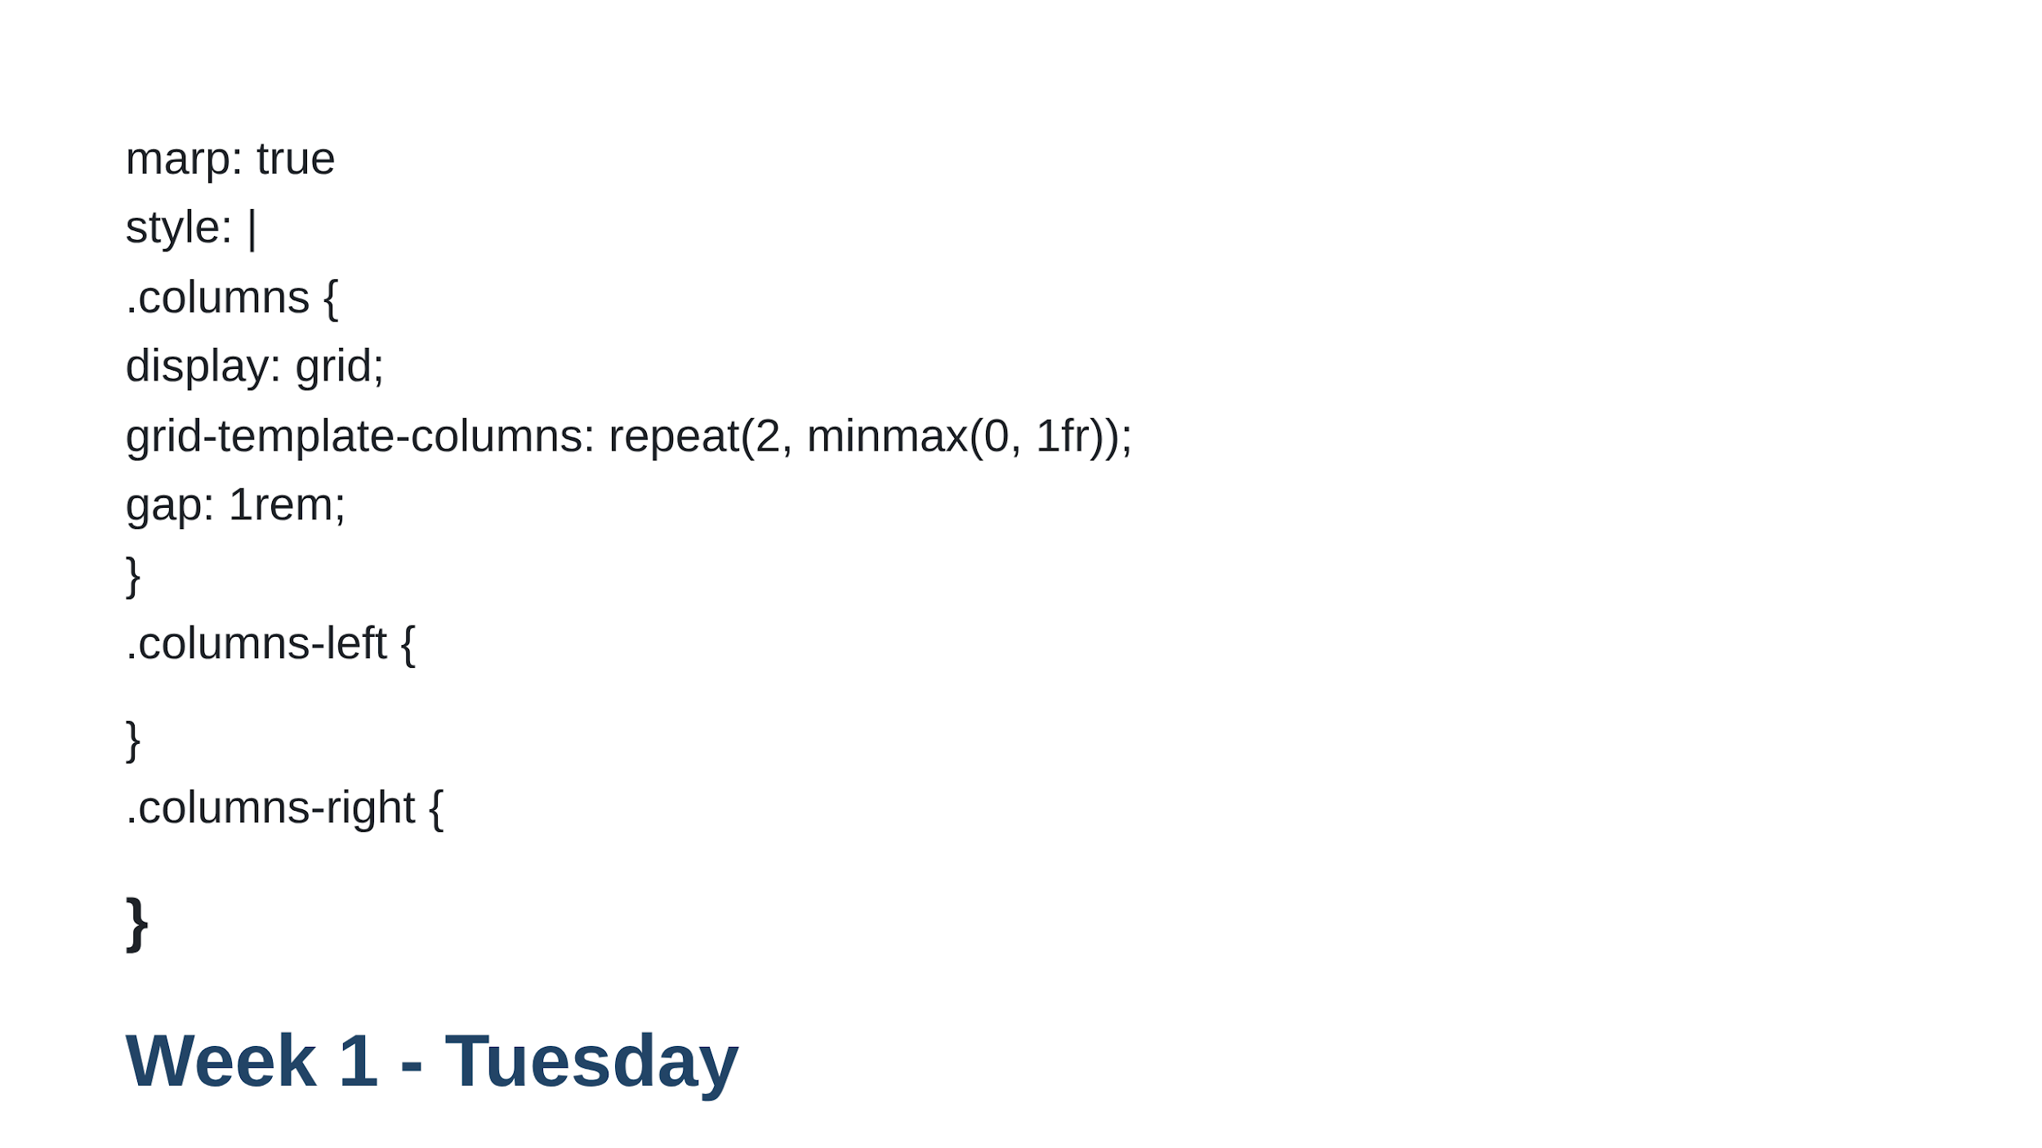

Slide 3
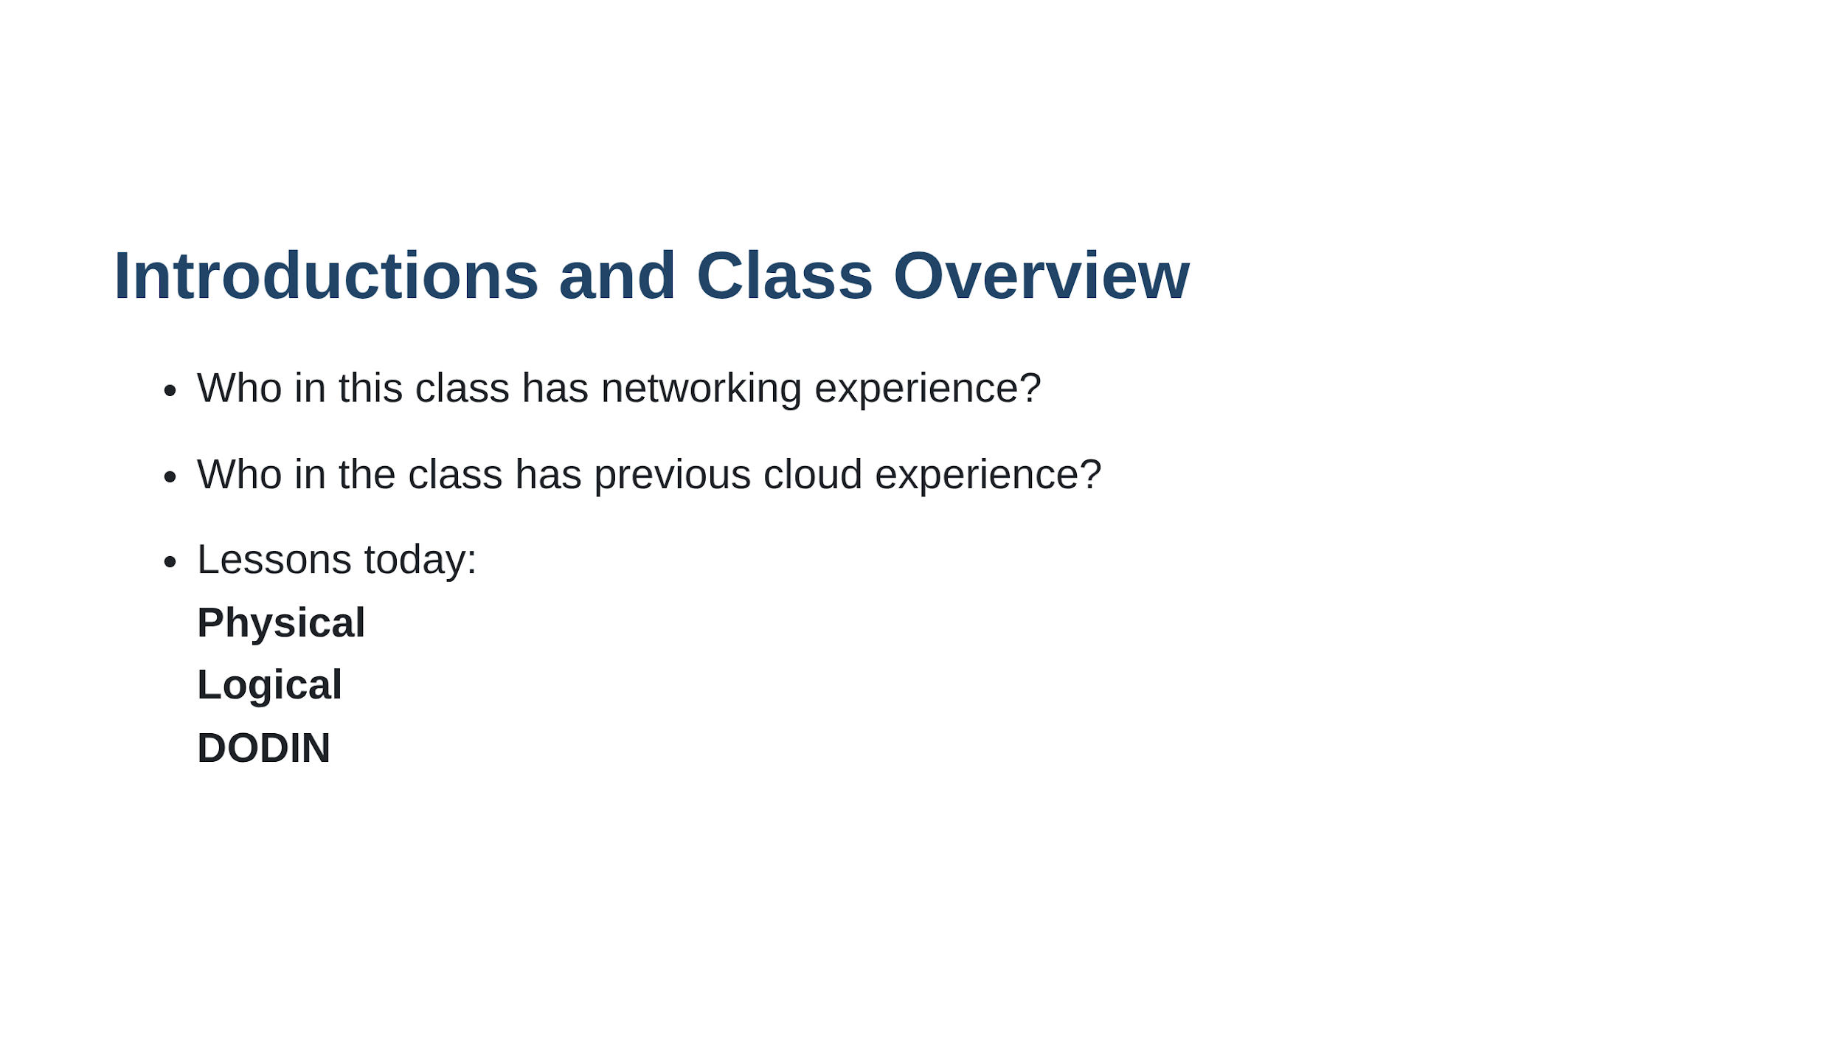

Slide 4
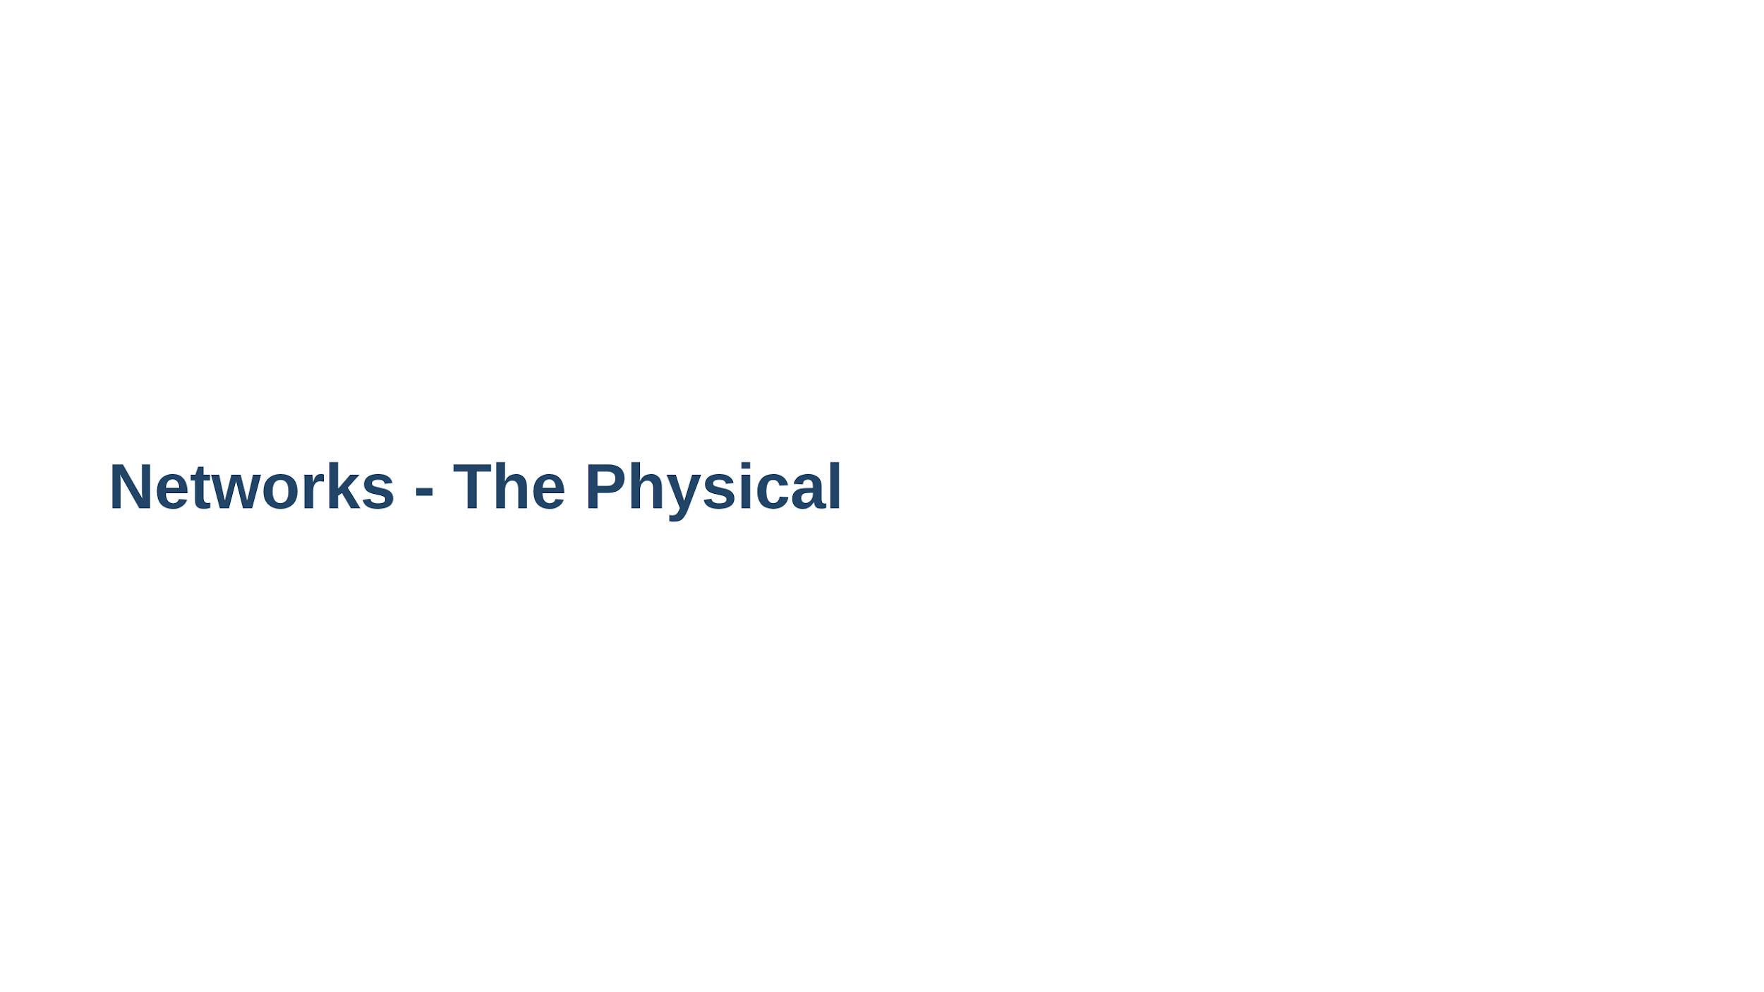

Slide 5
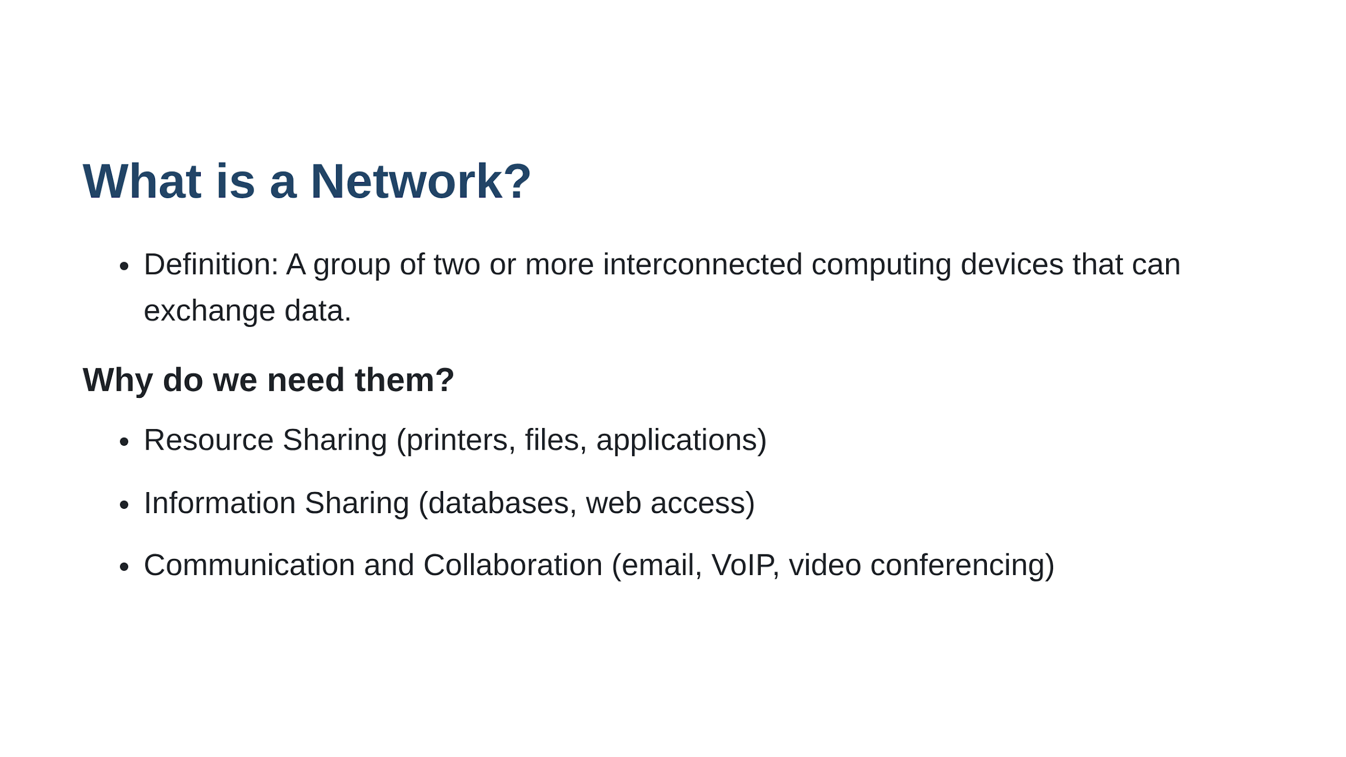

Slide 6
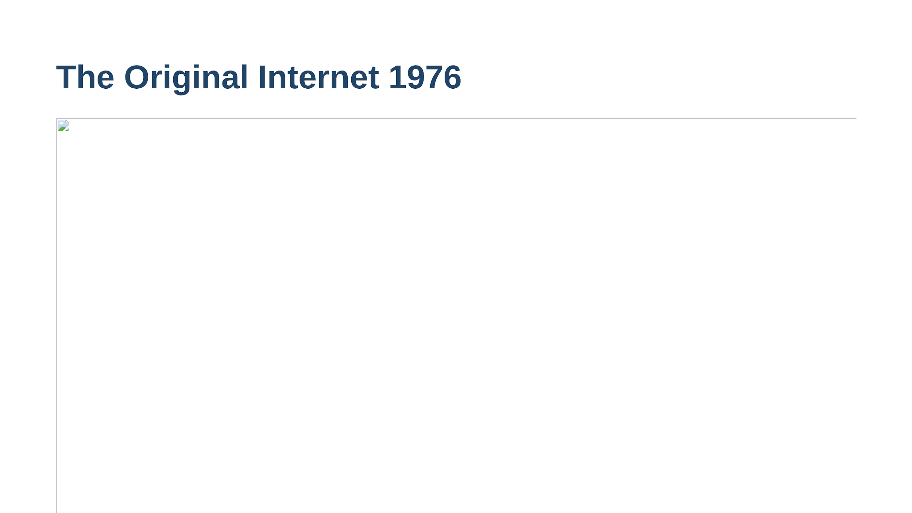

Slide 7
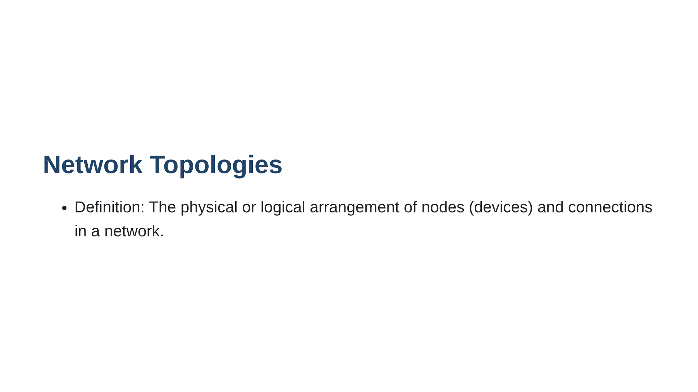

Slide 8
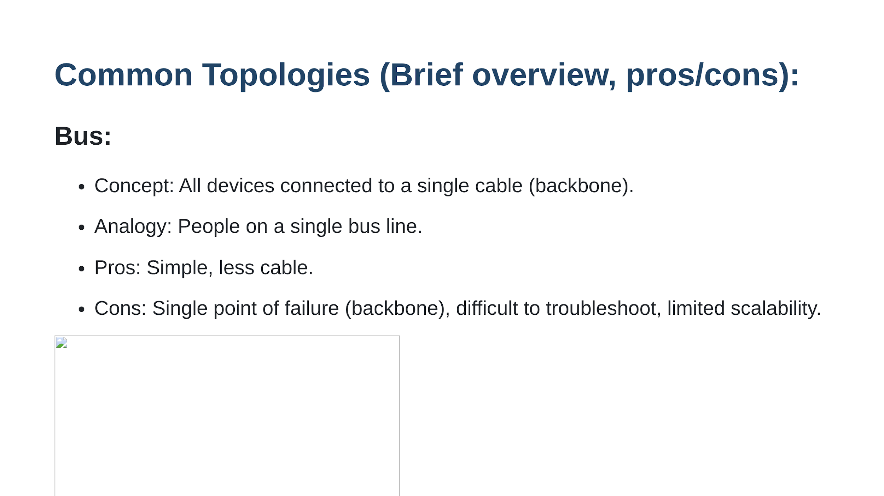

Slide 9
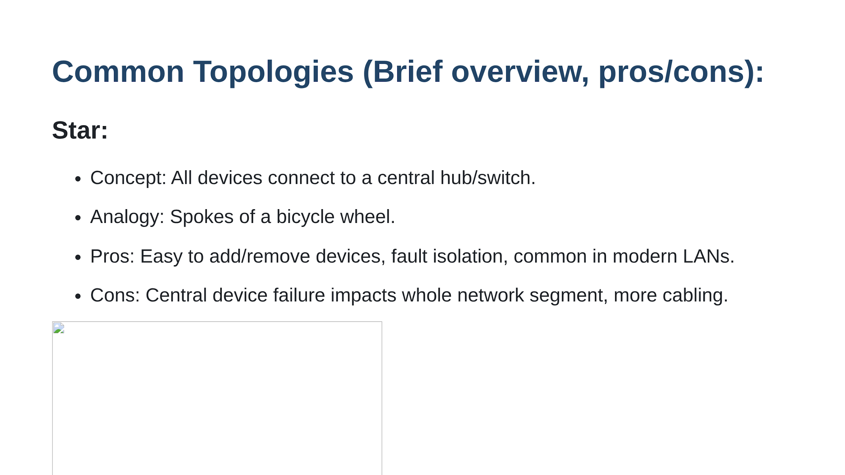

Slide 10
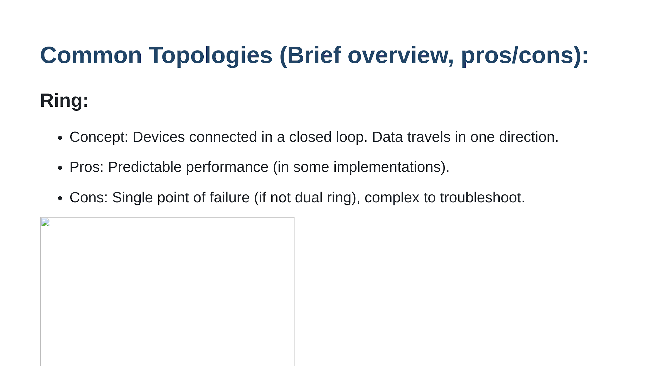

Slide 11
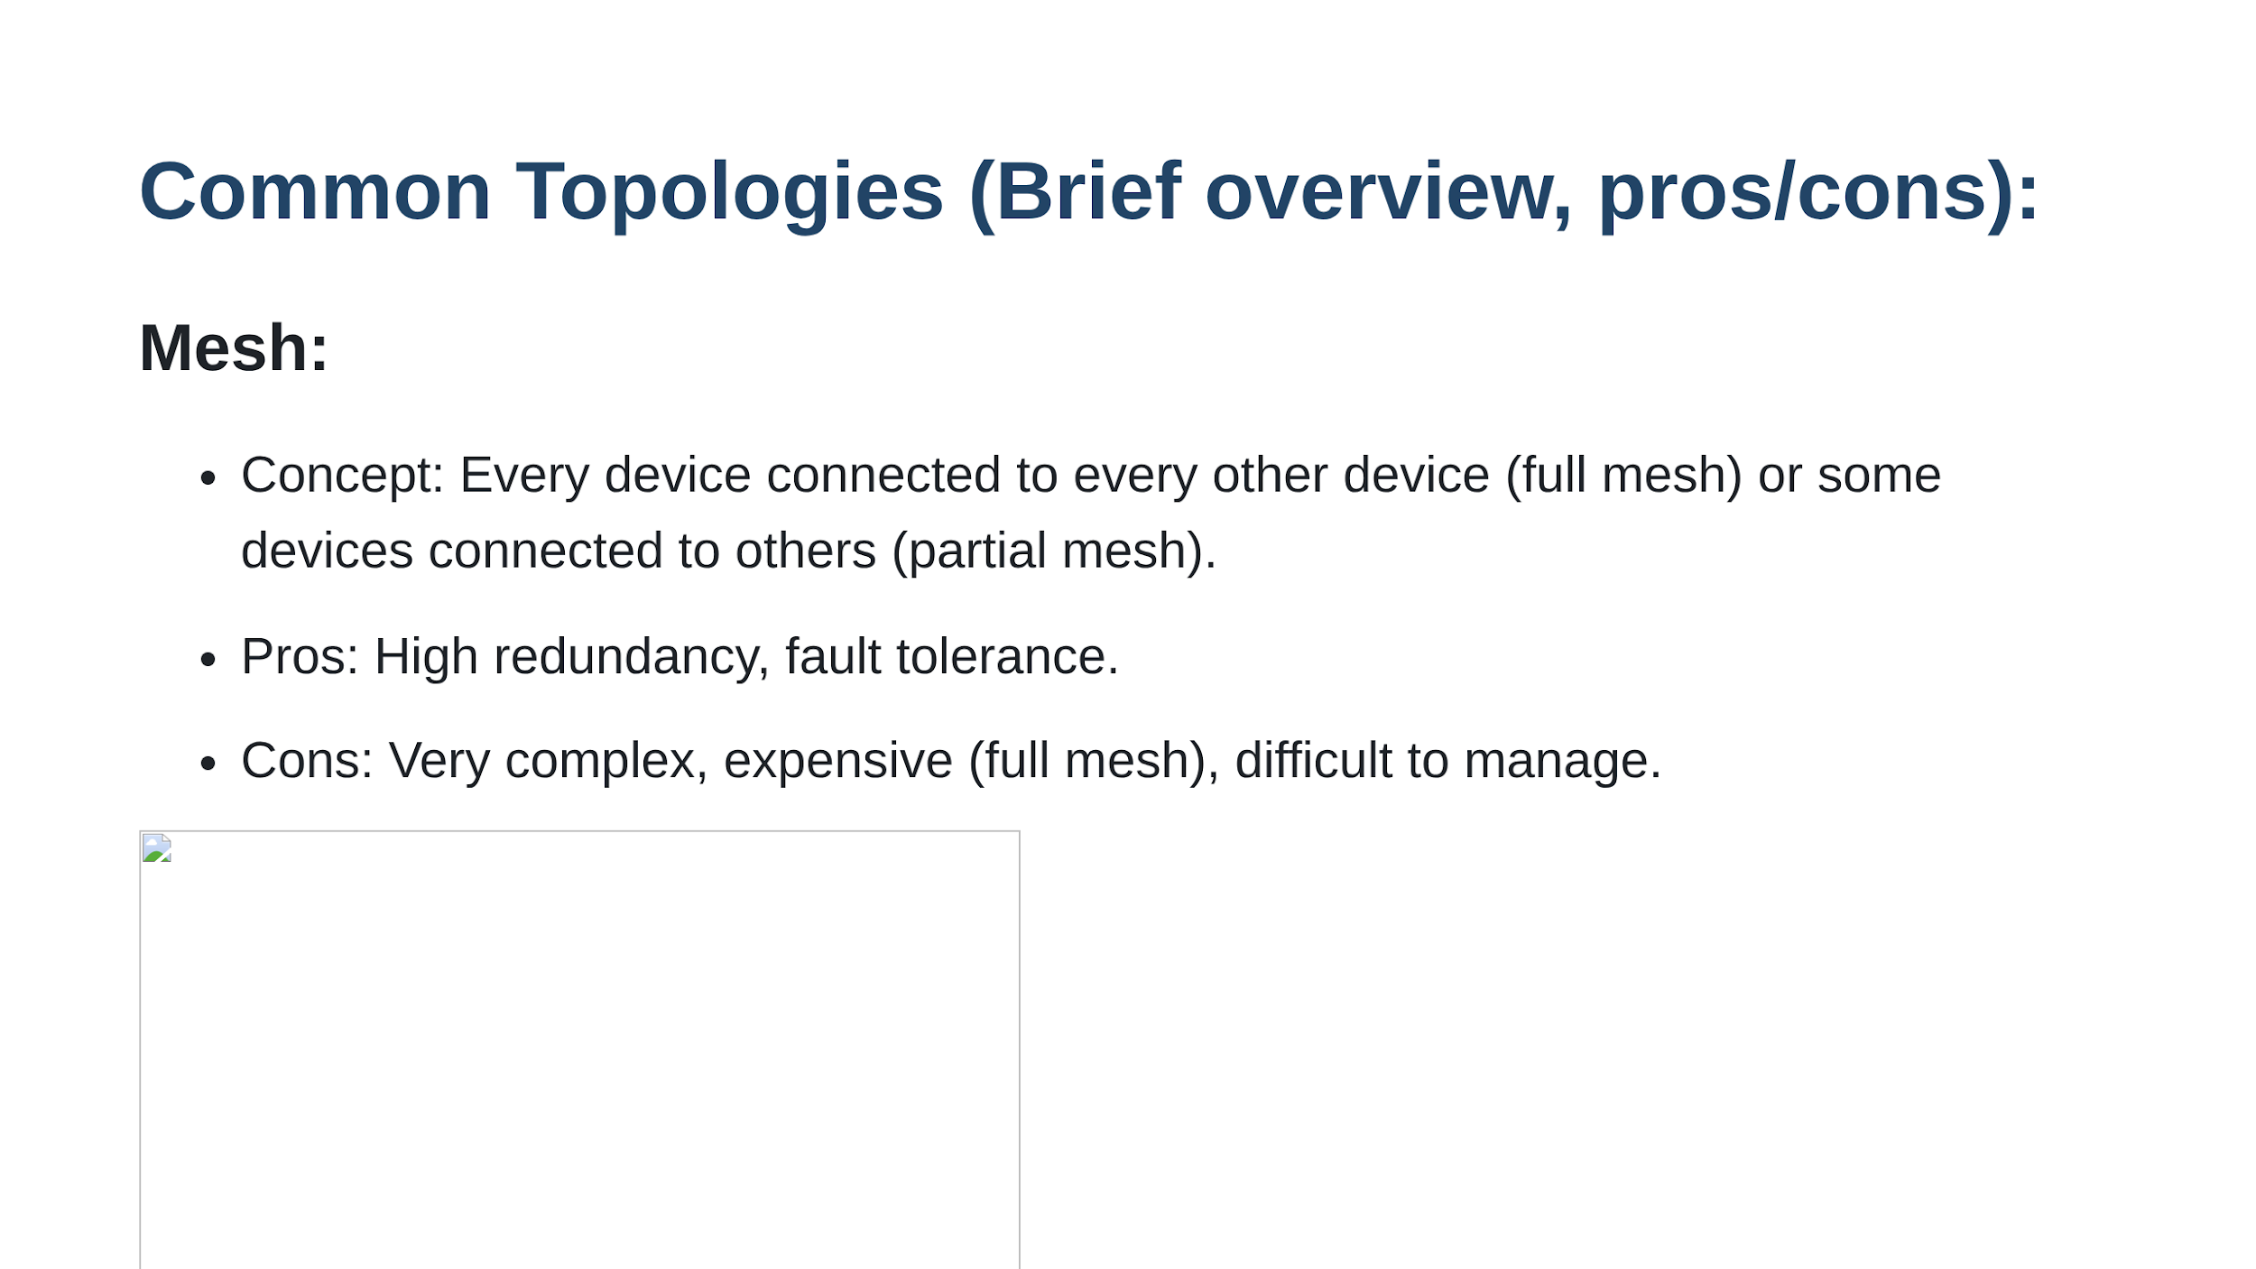

Slide 12
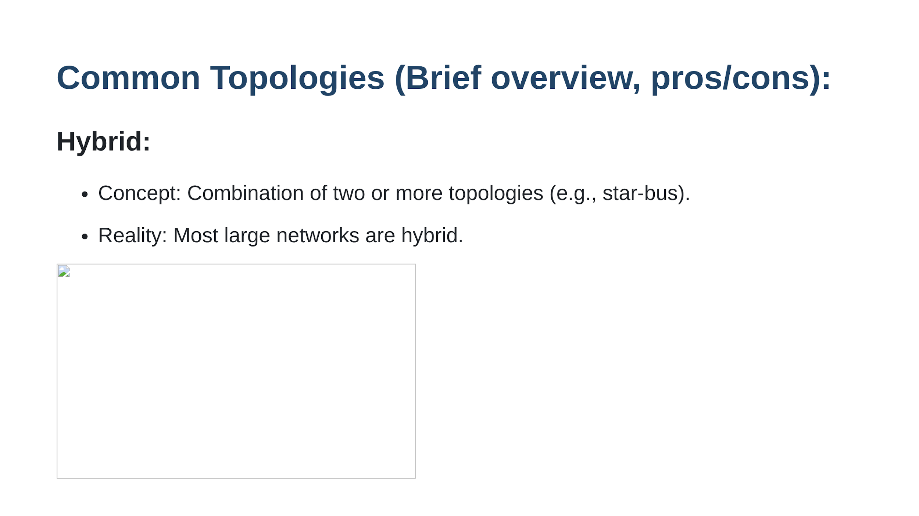

Slide 13
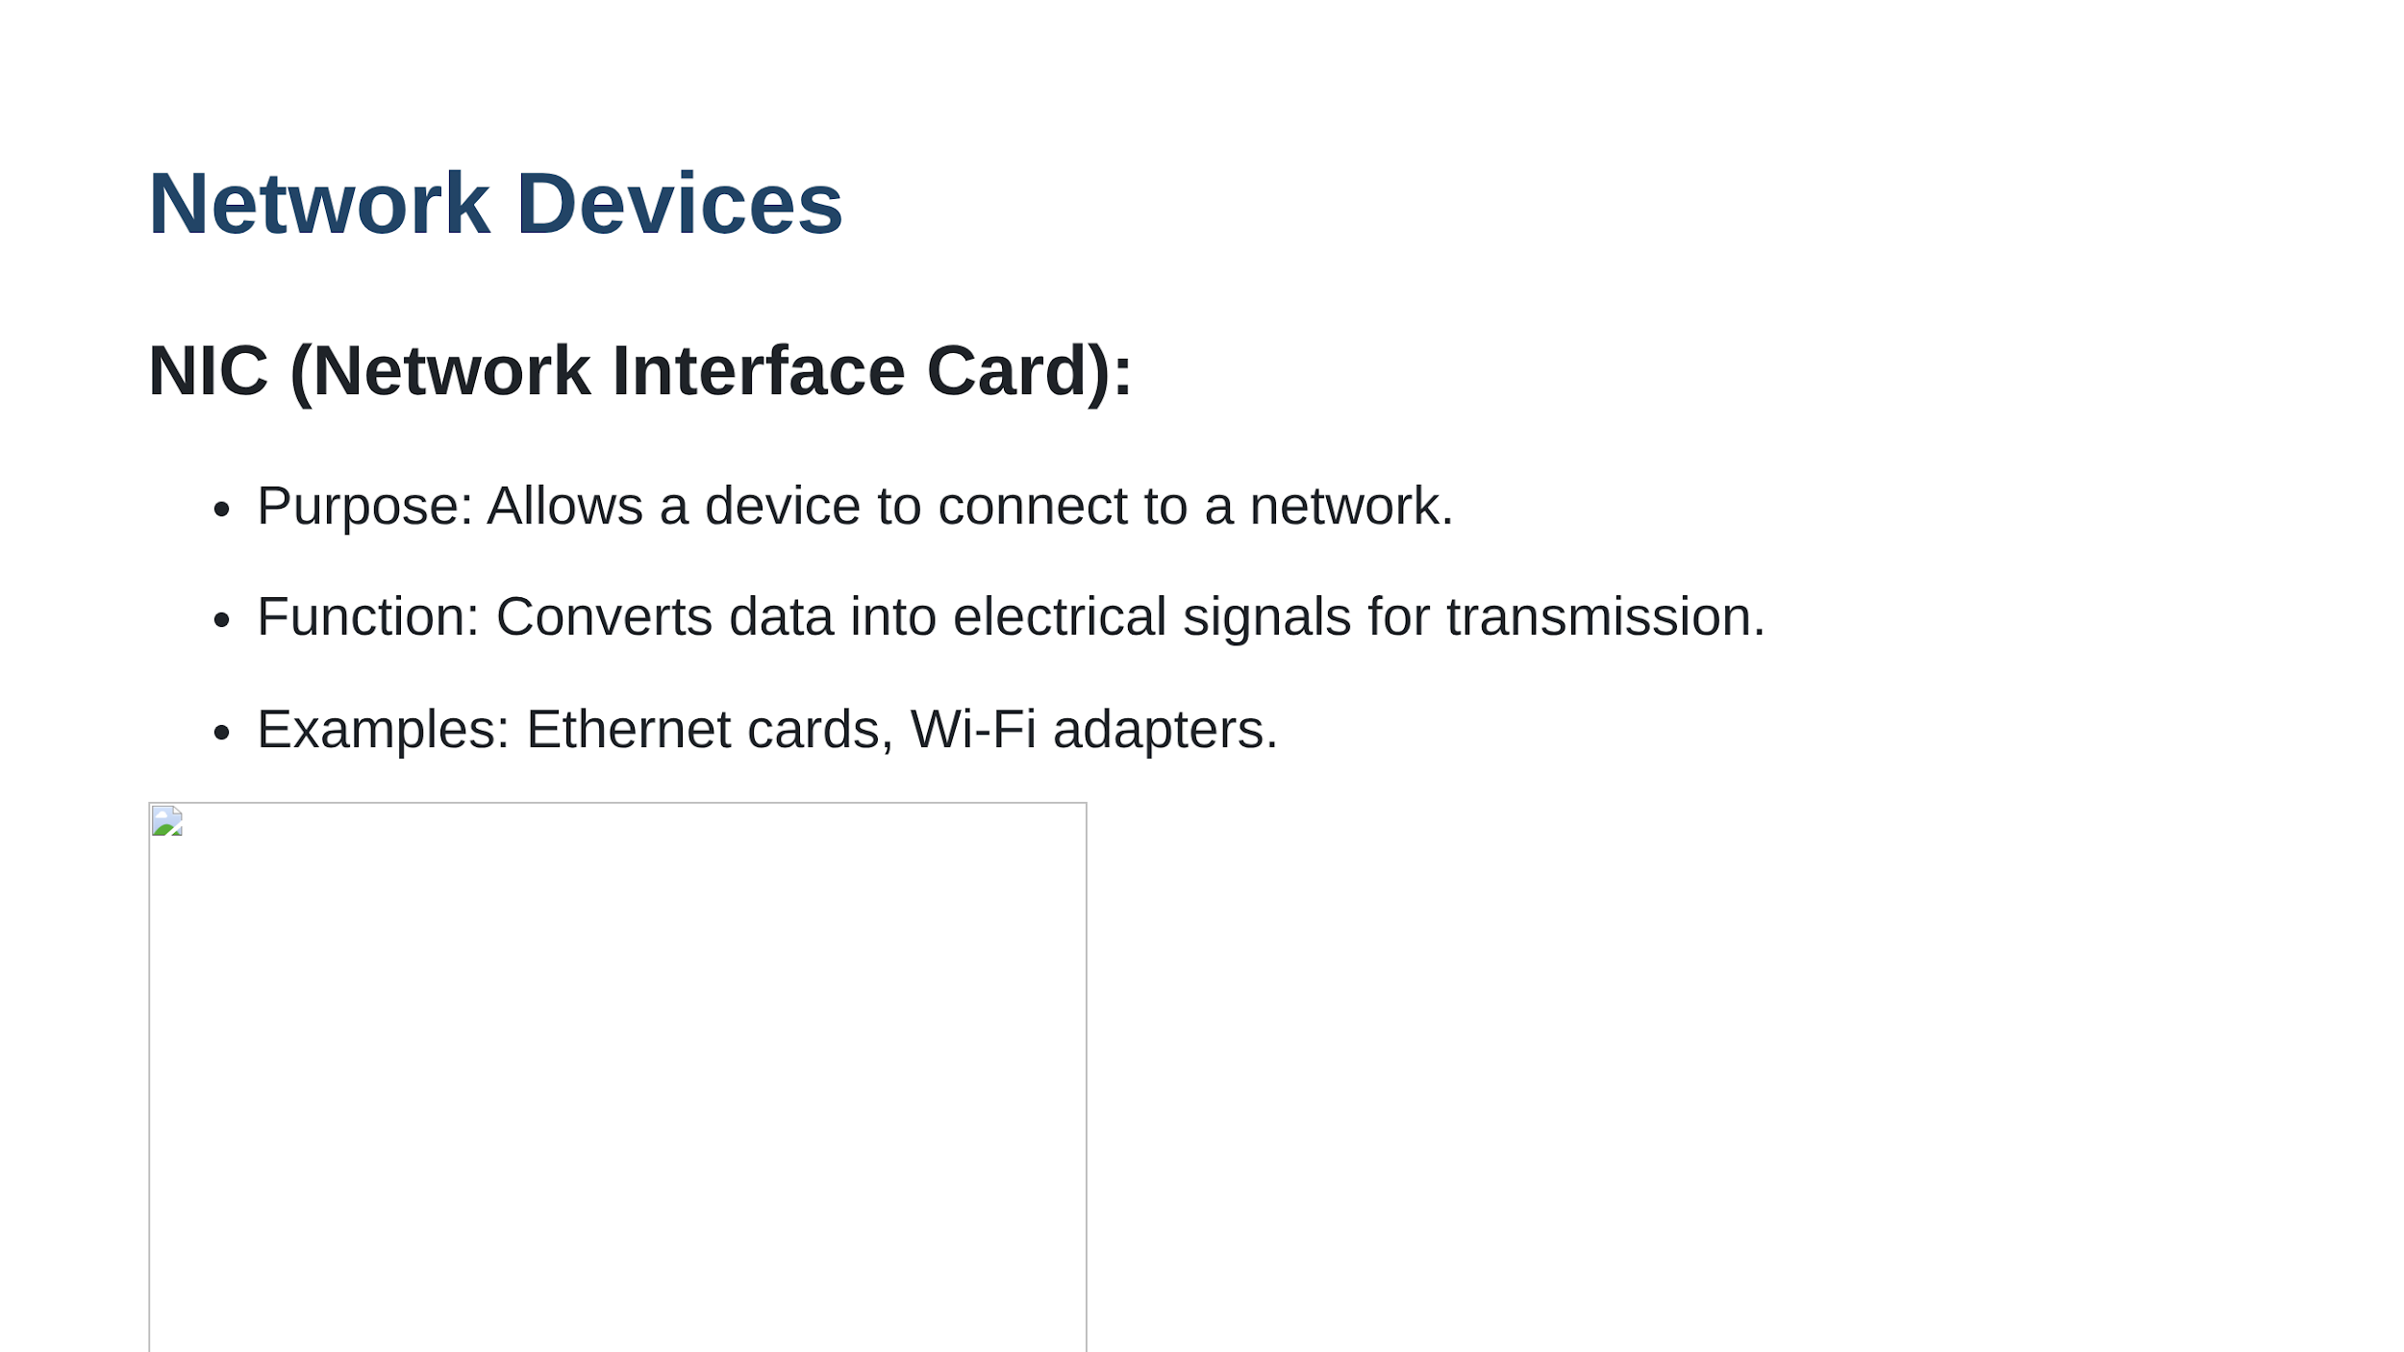

Slide 14
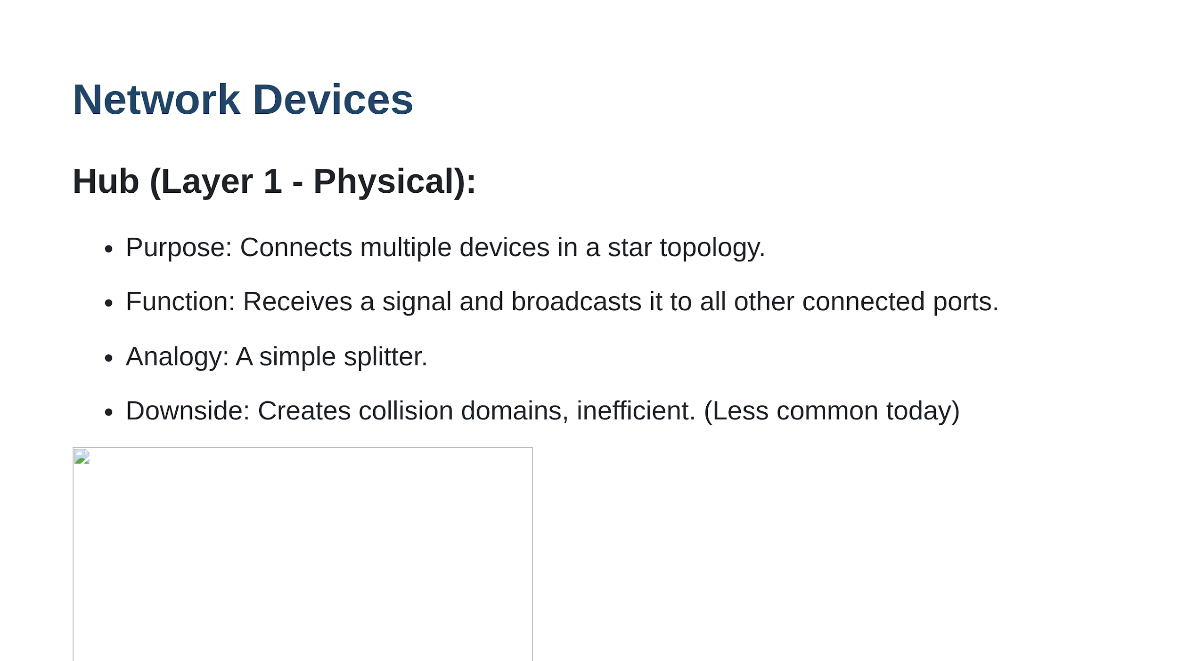

Slide 15
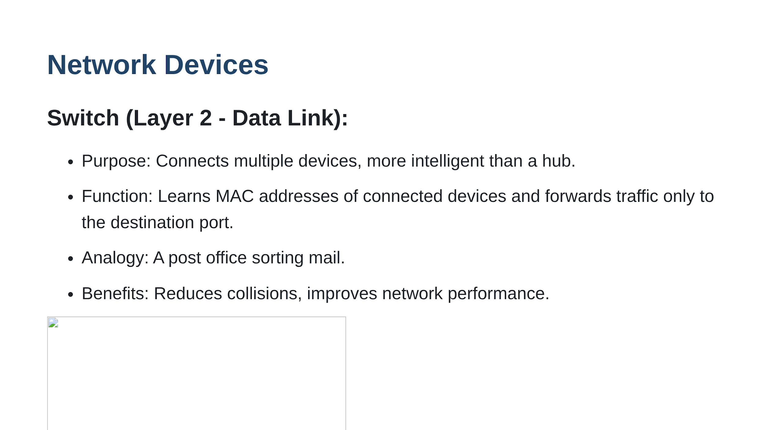

Slide 16
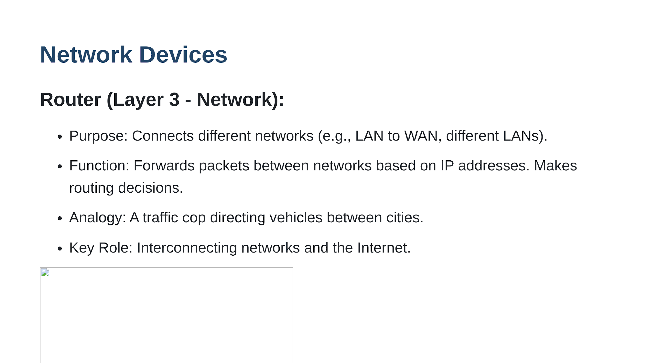

Slide 17
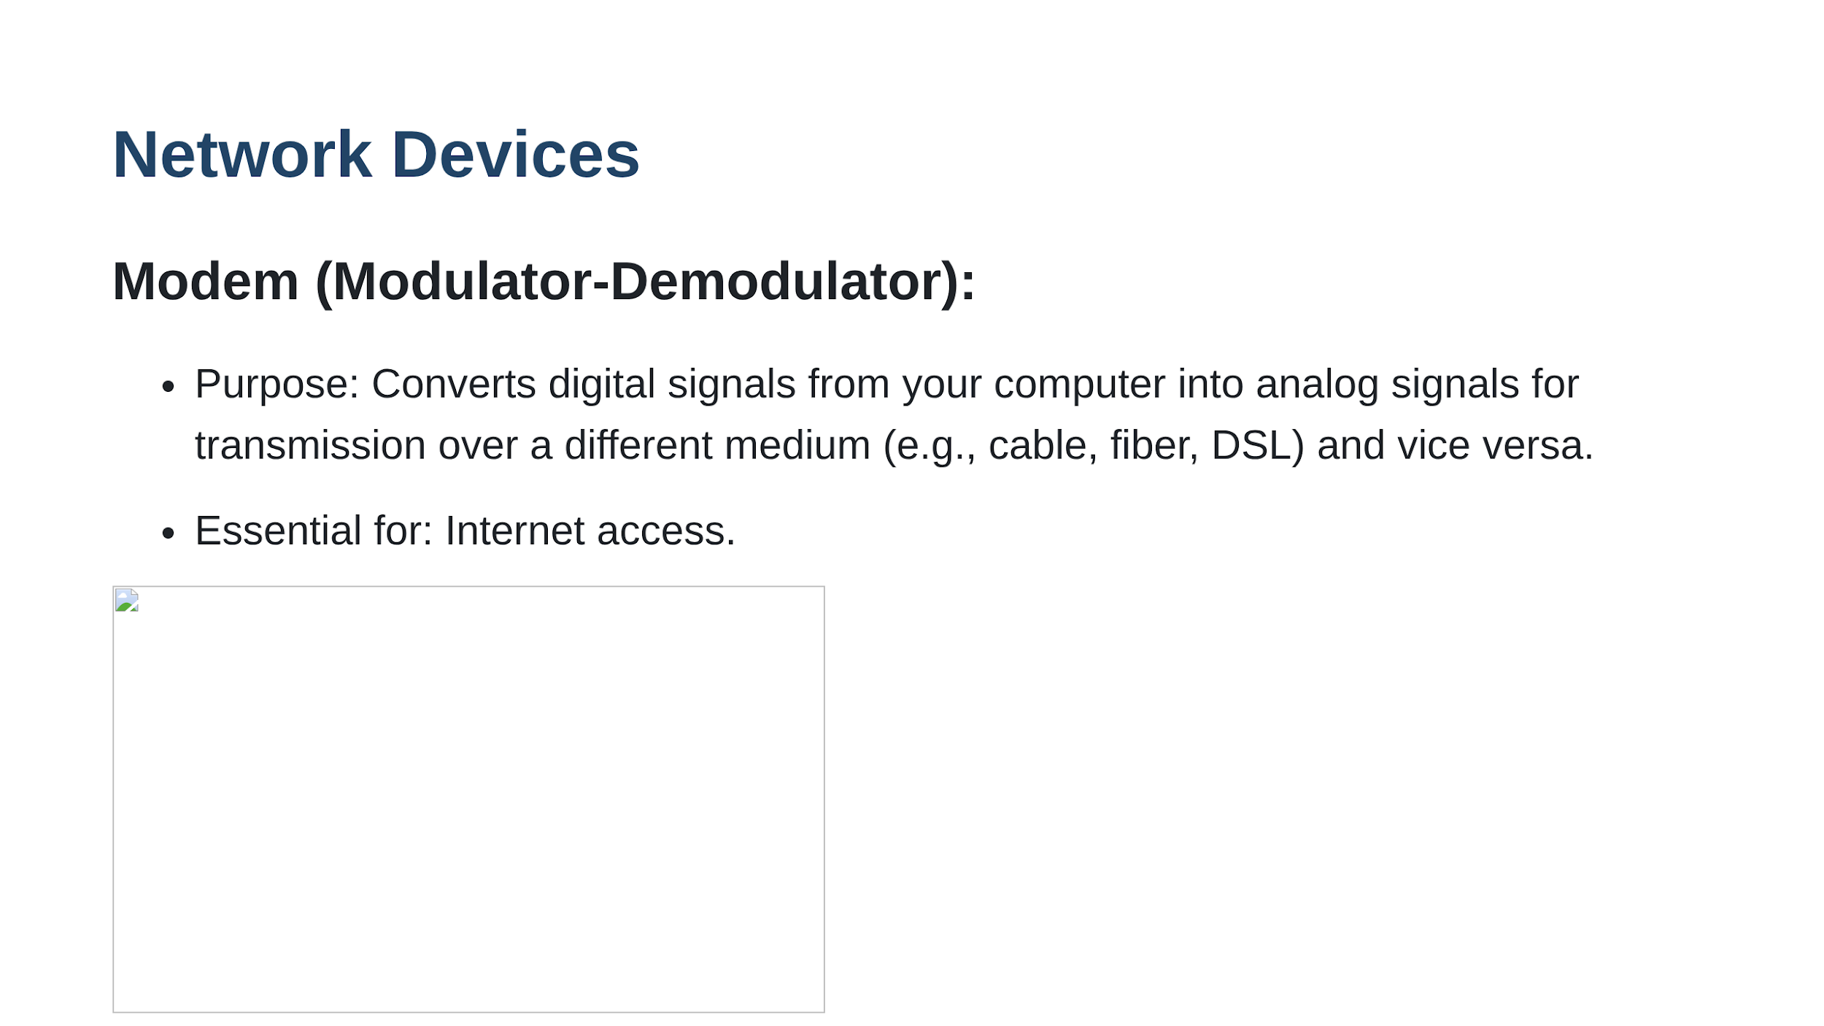

Slide 18
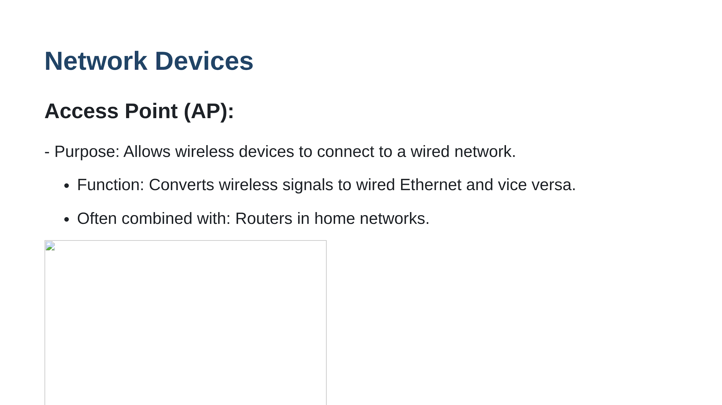

Slide 19
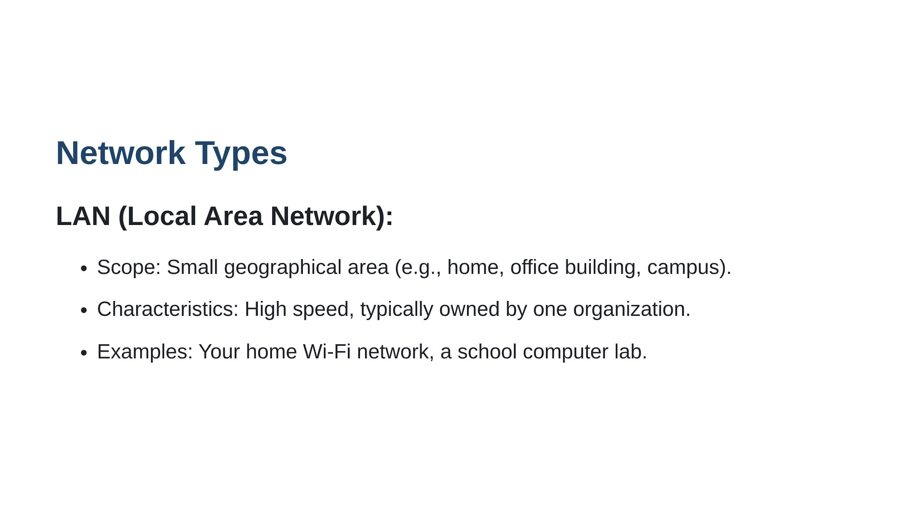

Slide 20
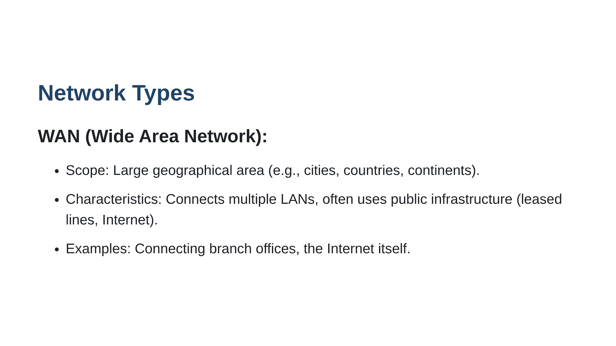

Slide 21
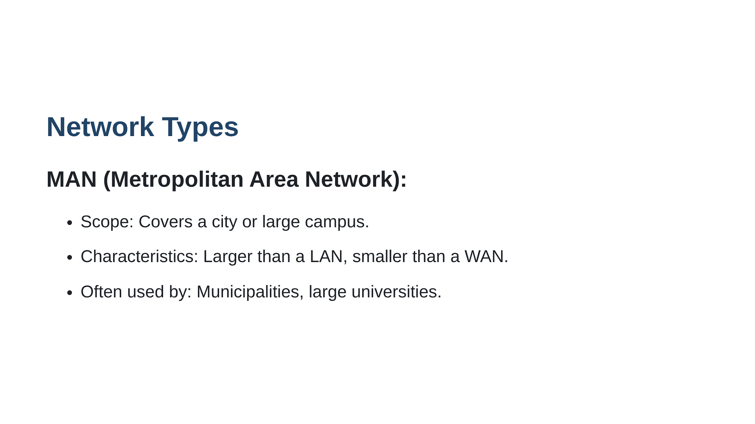

Slide 22
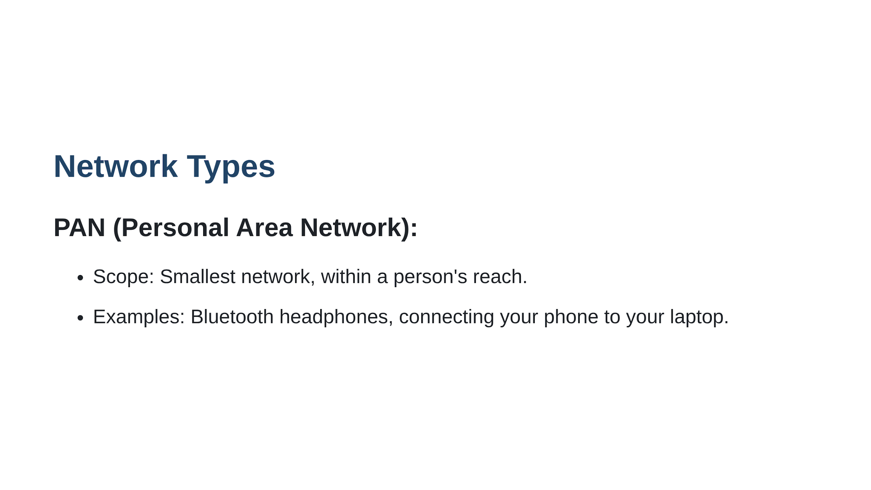

Slide 23
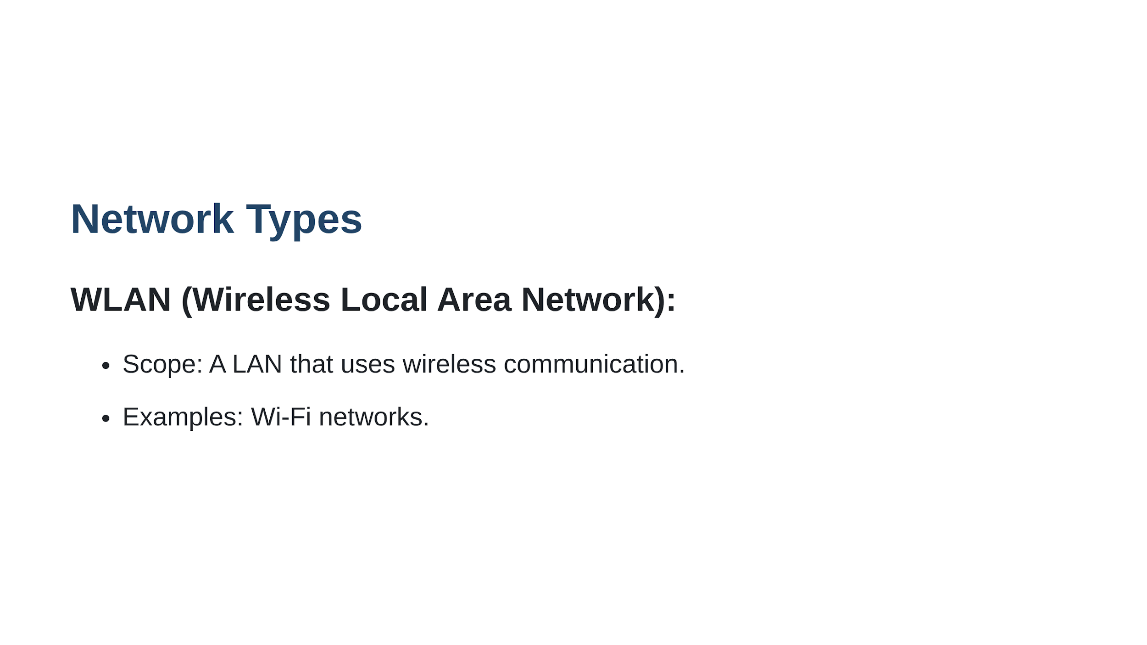

Slide 24
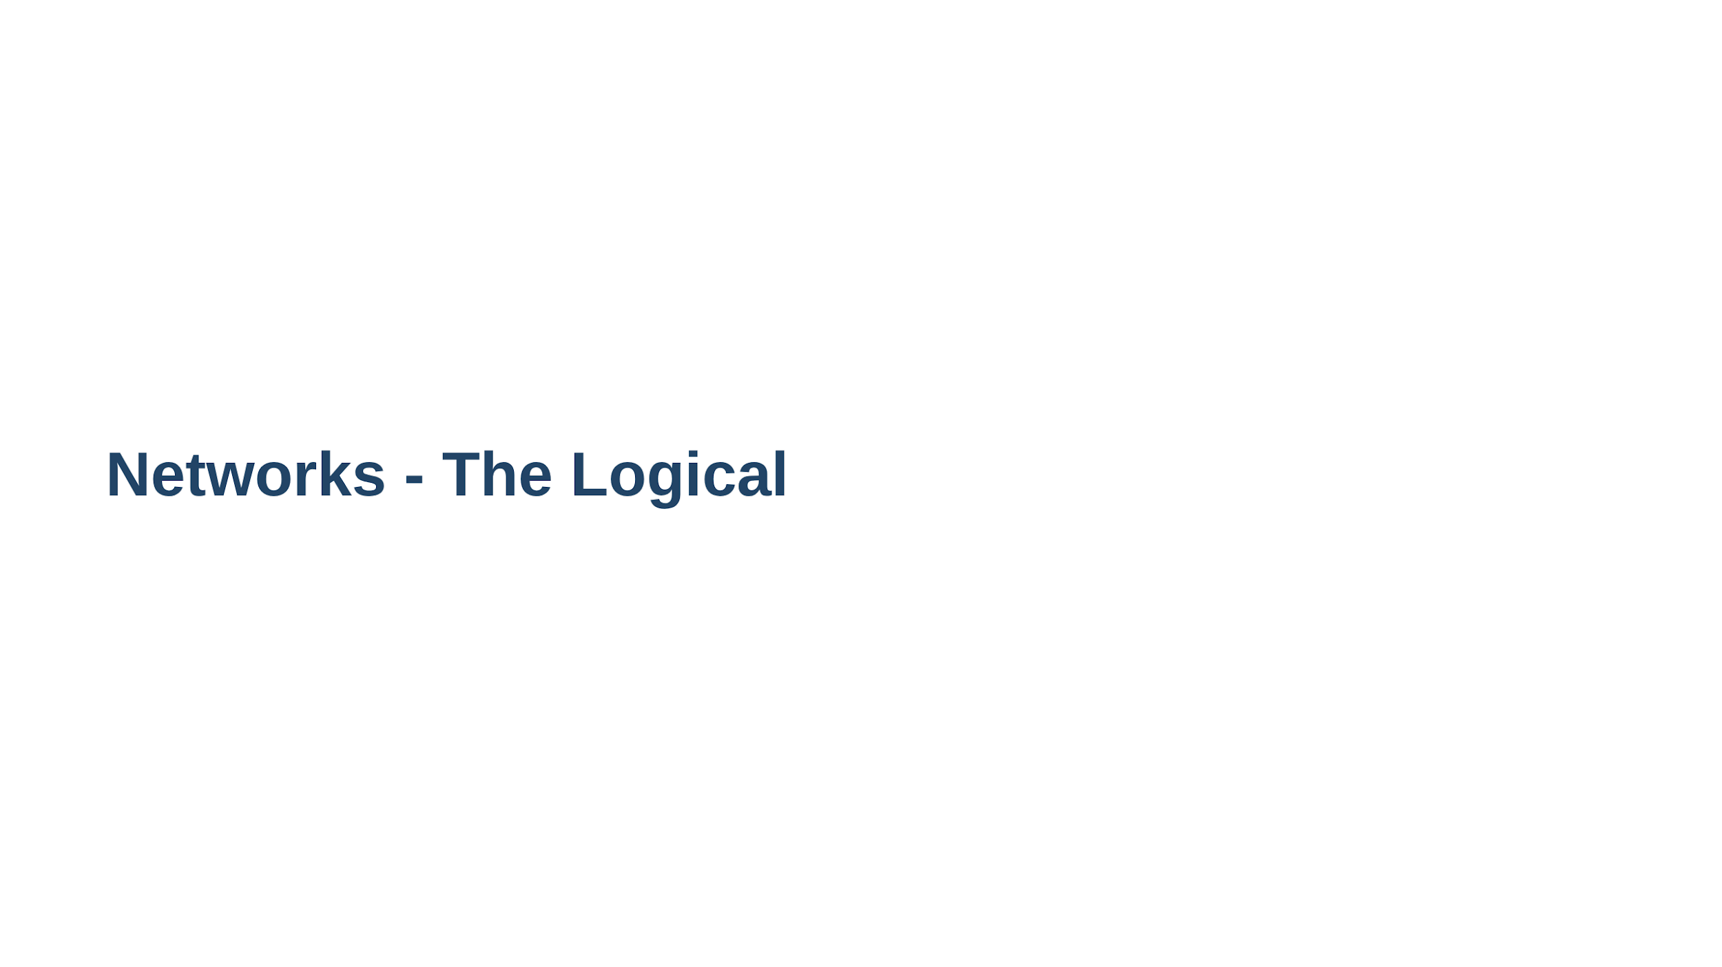

Slide 25
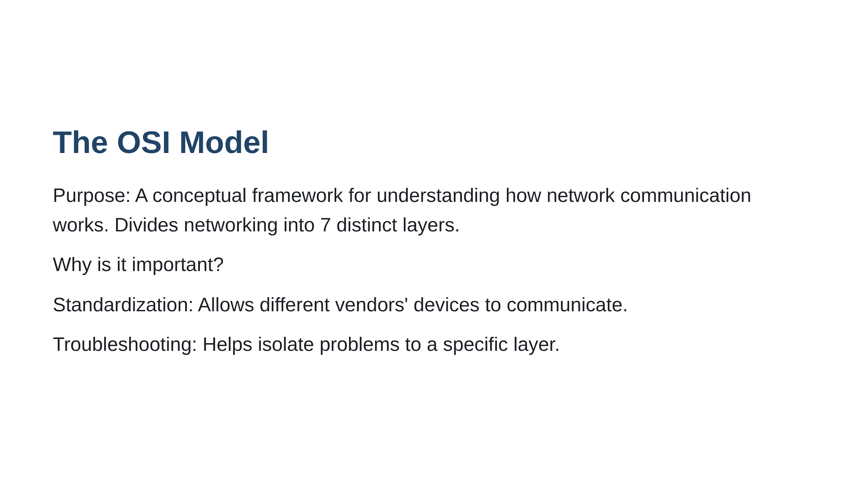

Slide 26
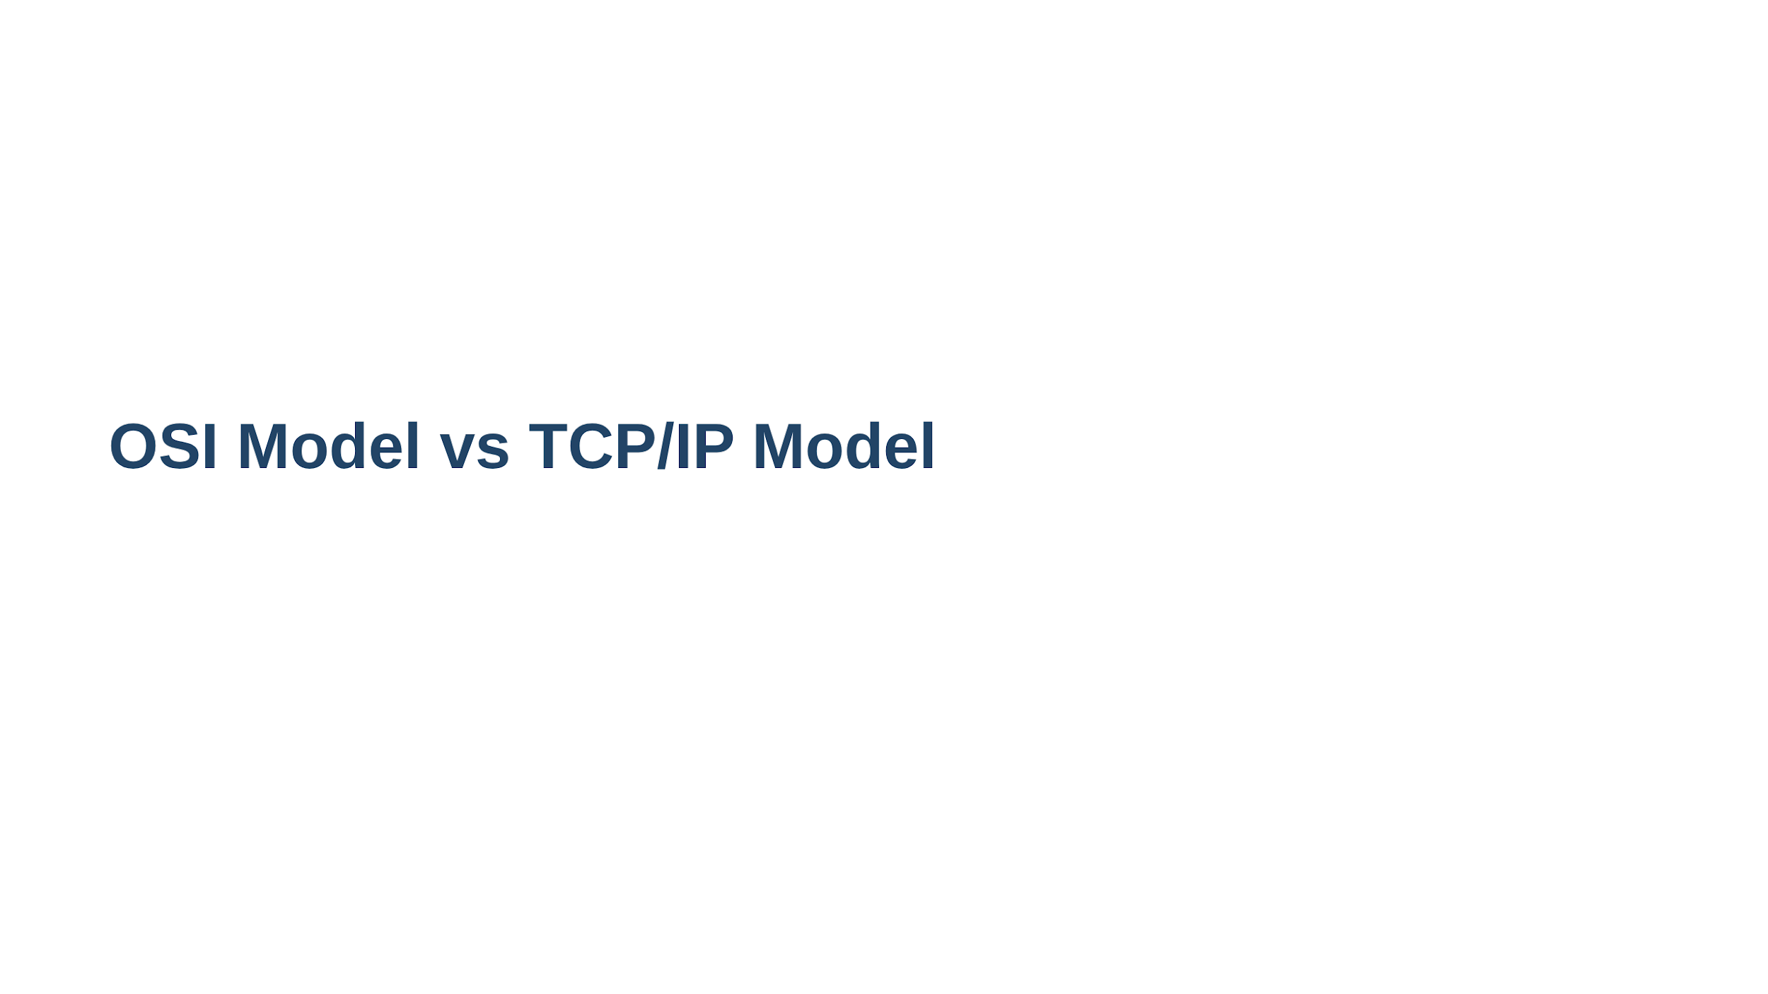

Slide 27
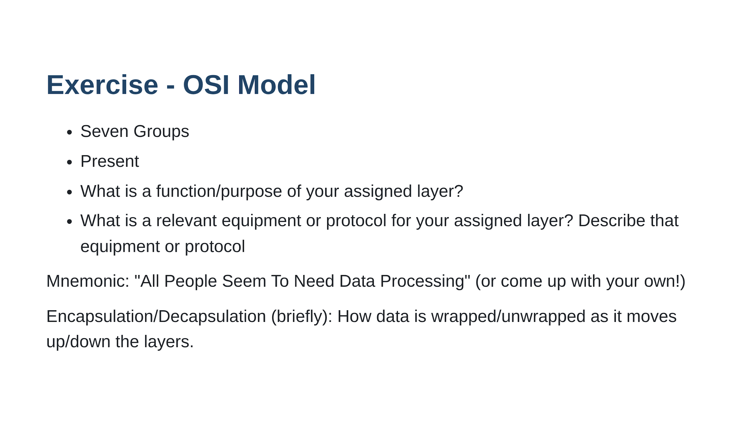

Slide 28
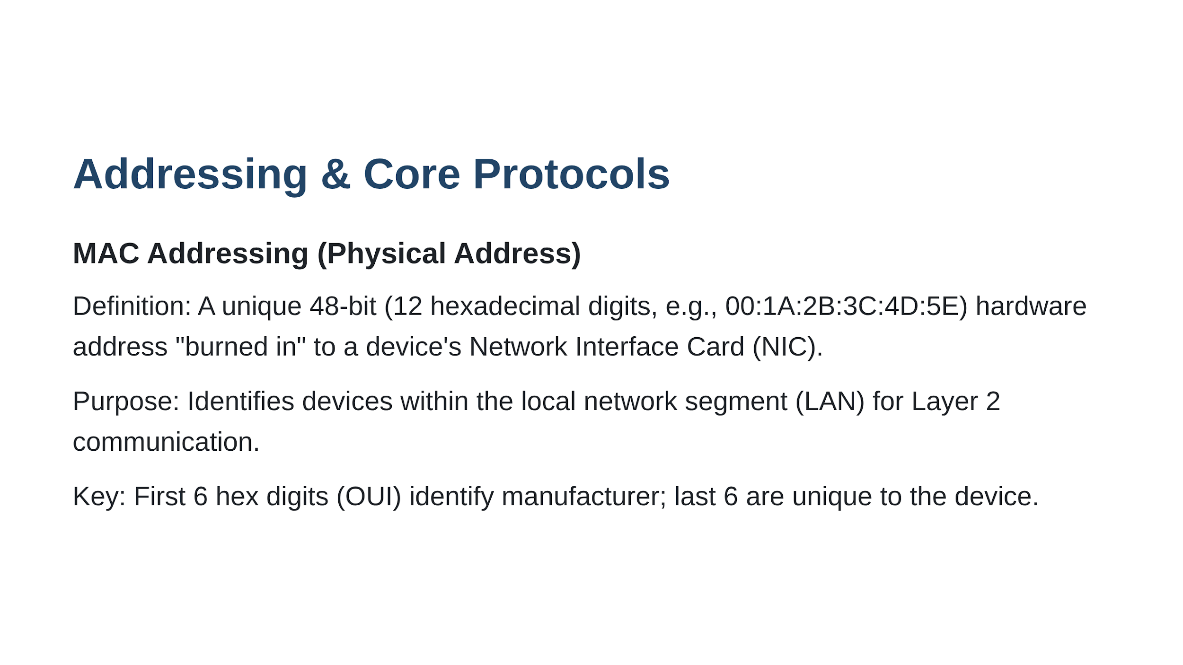

Slide 29
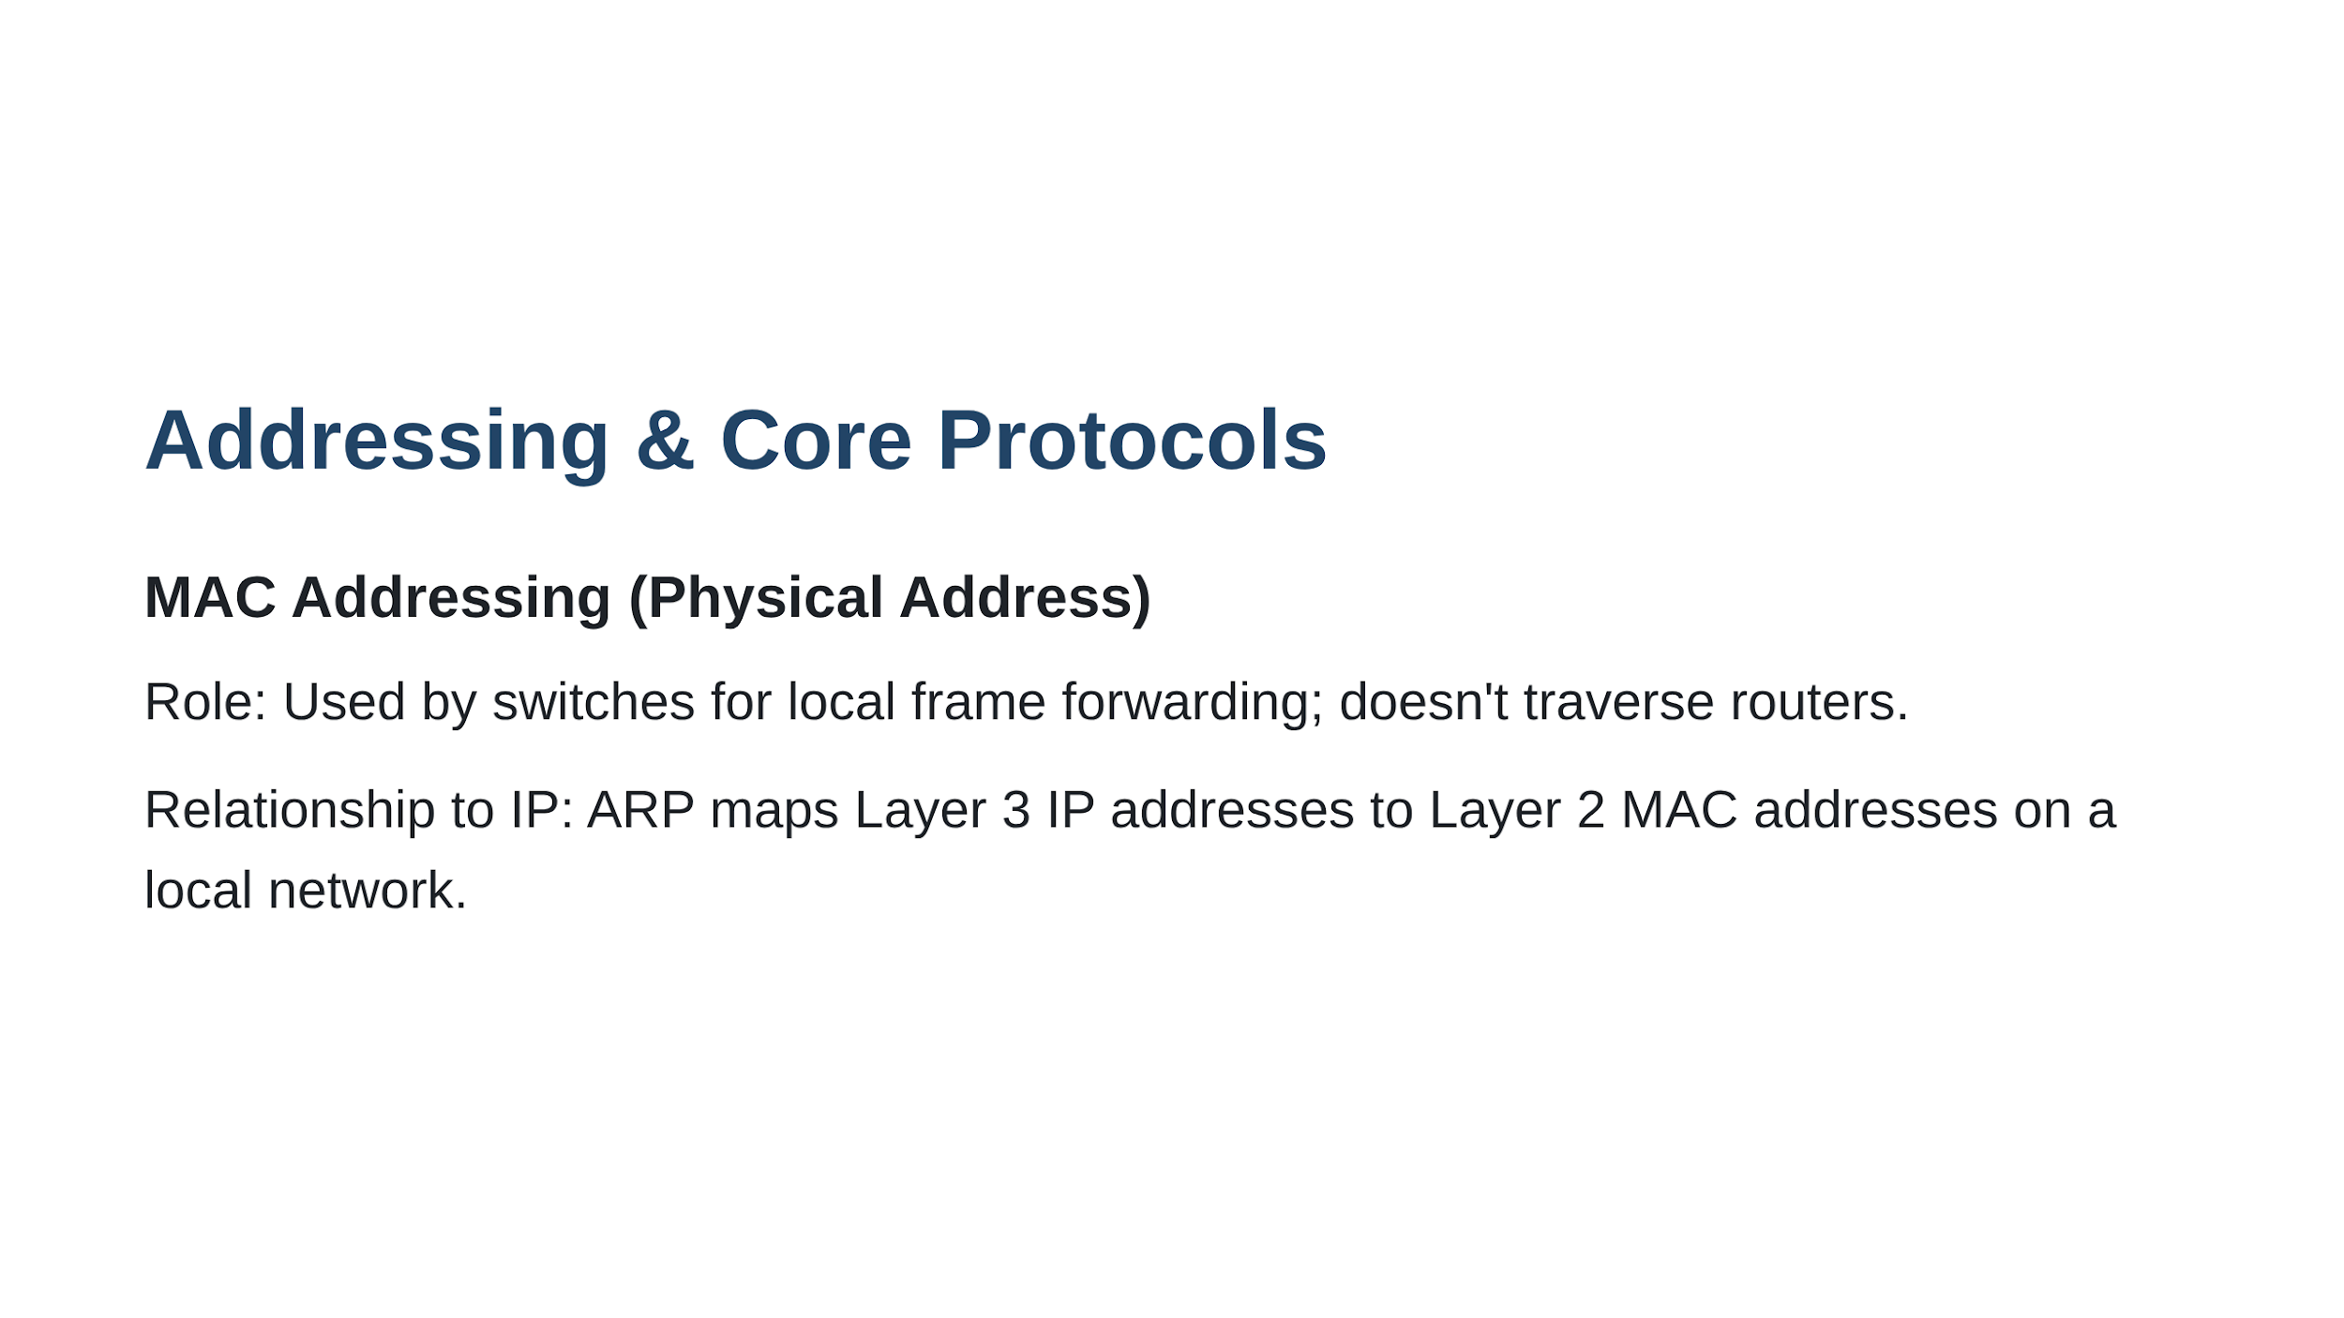

Slide 30
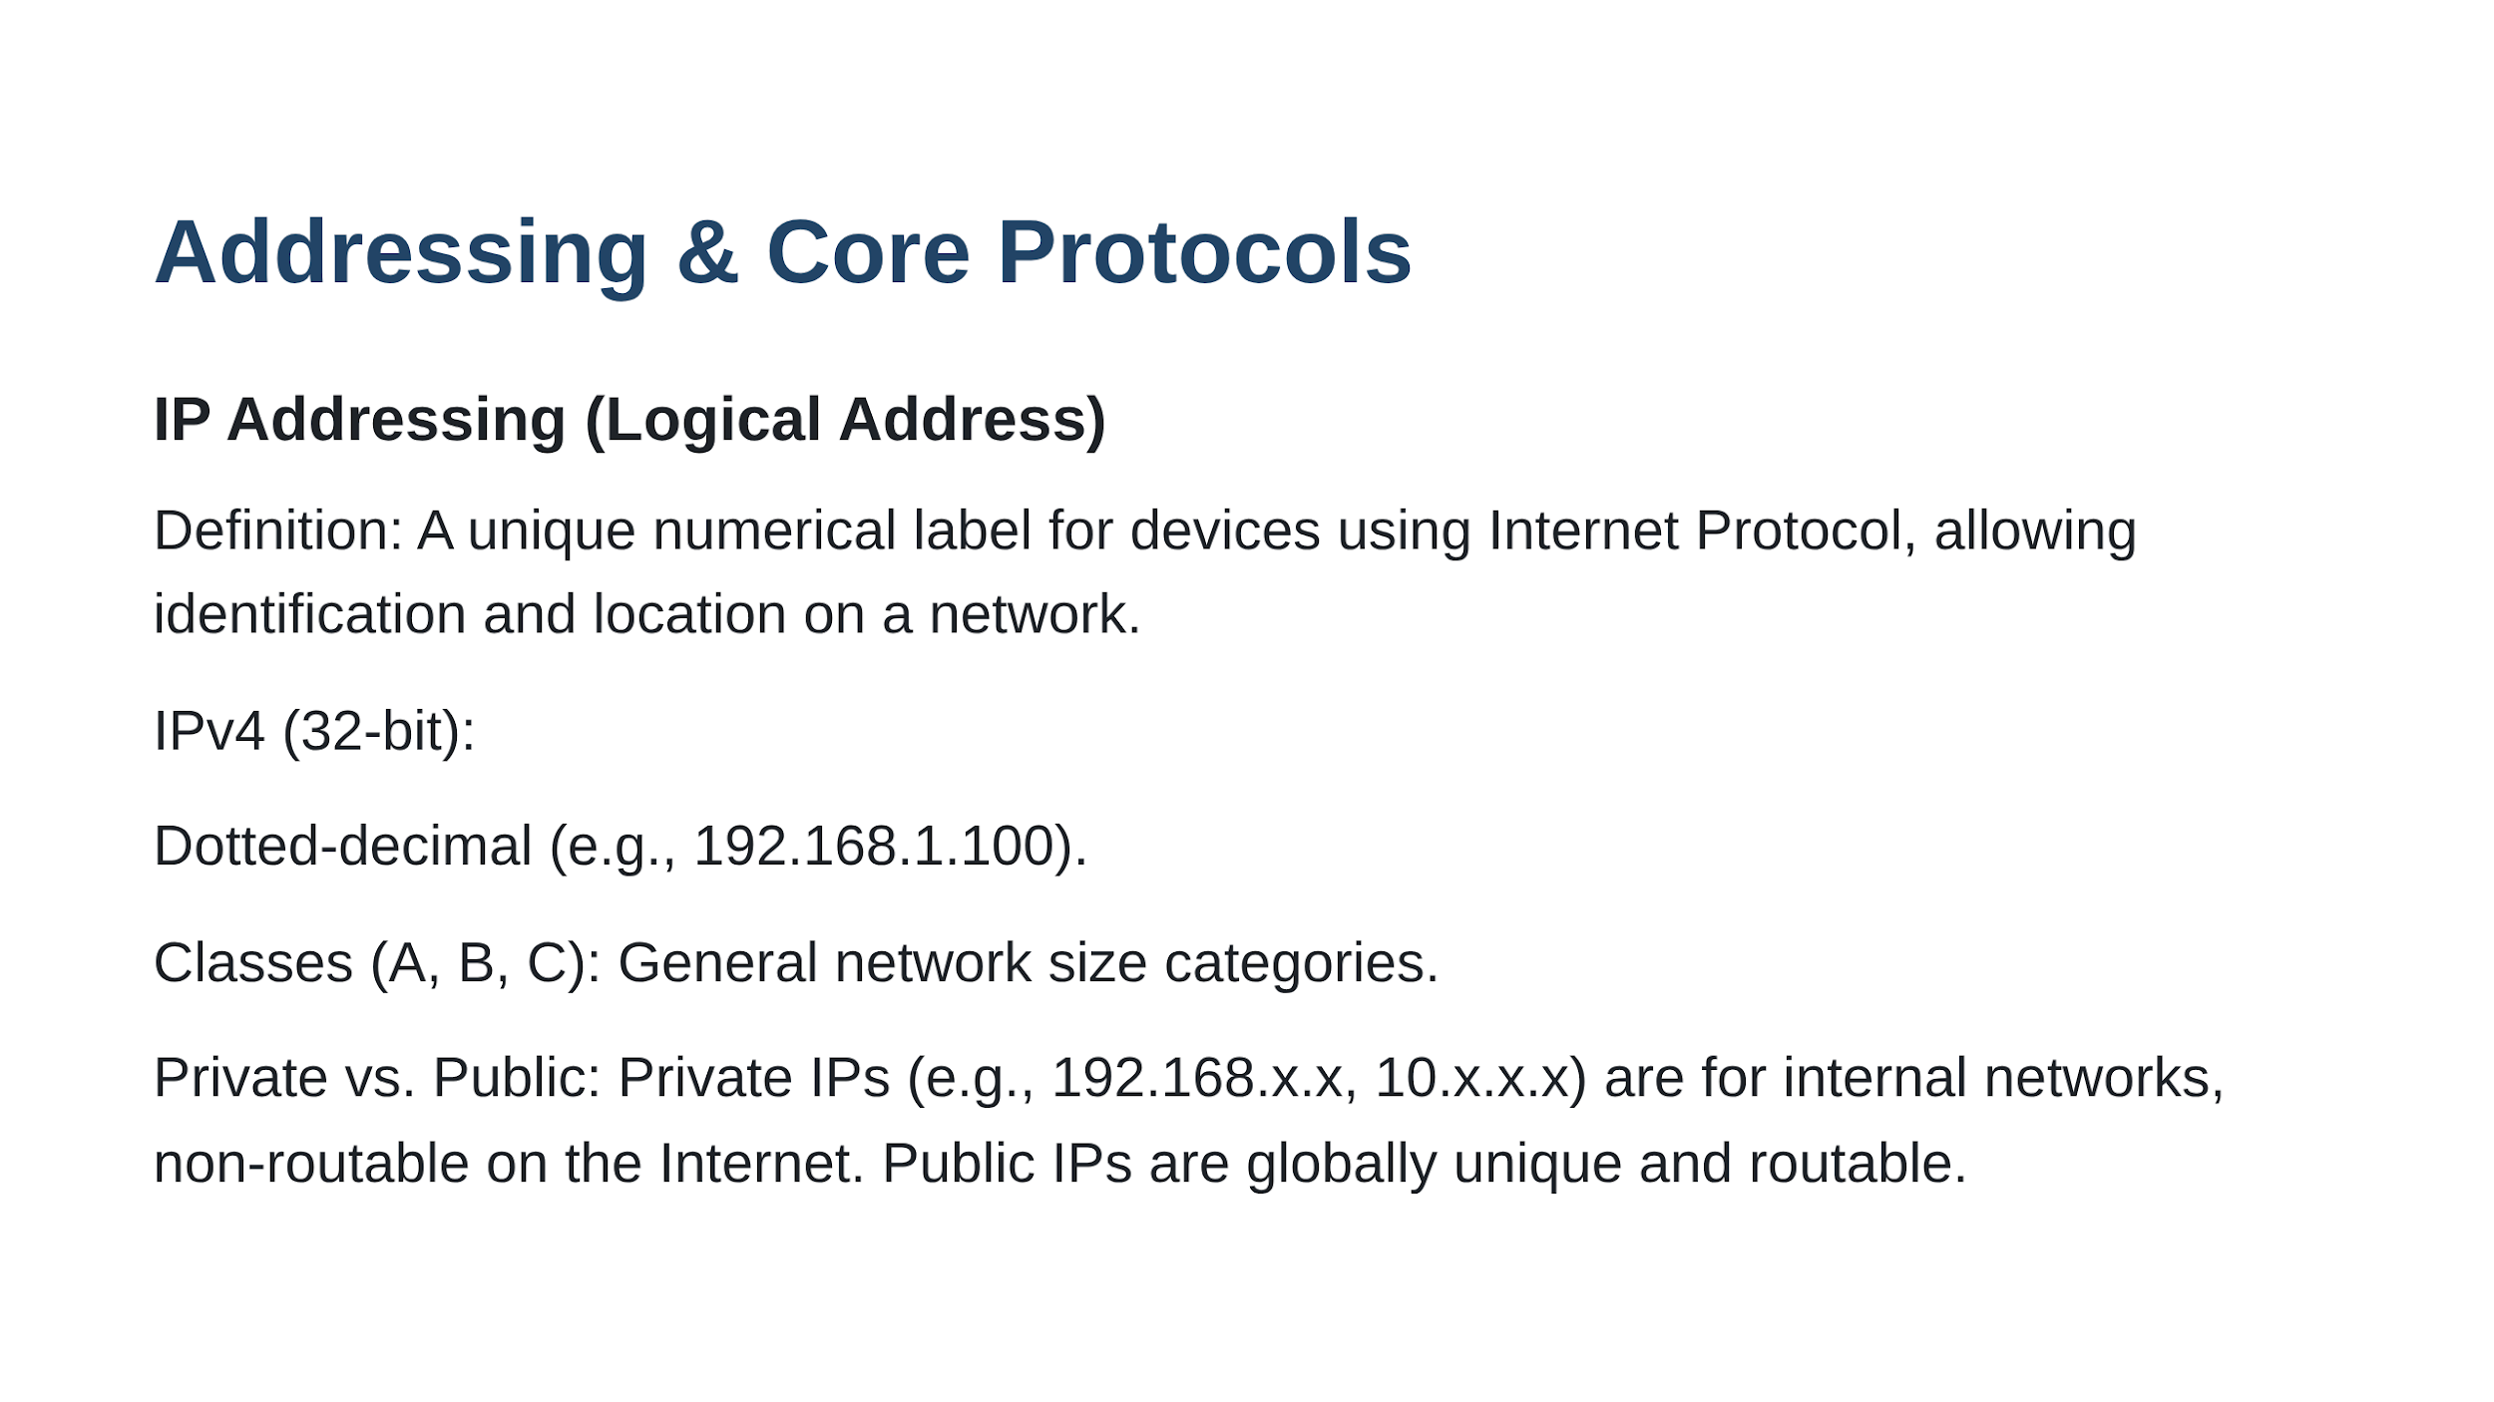

Slide 31
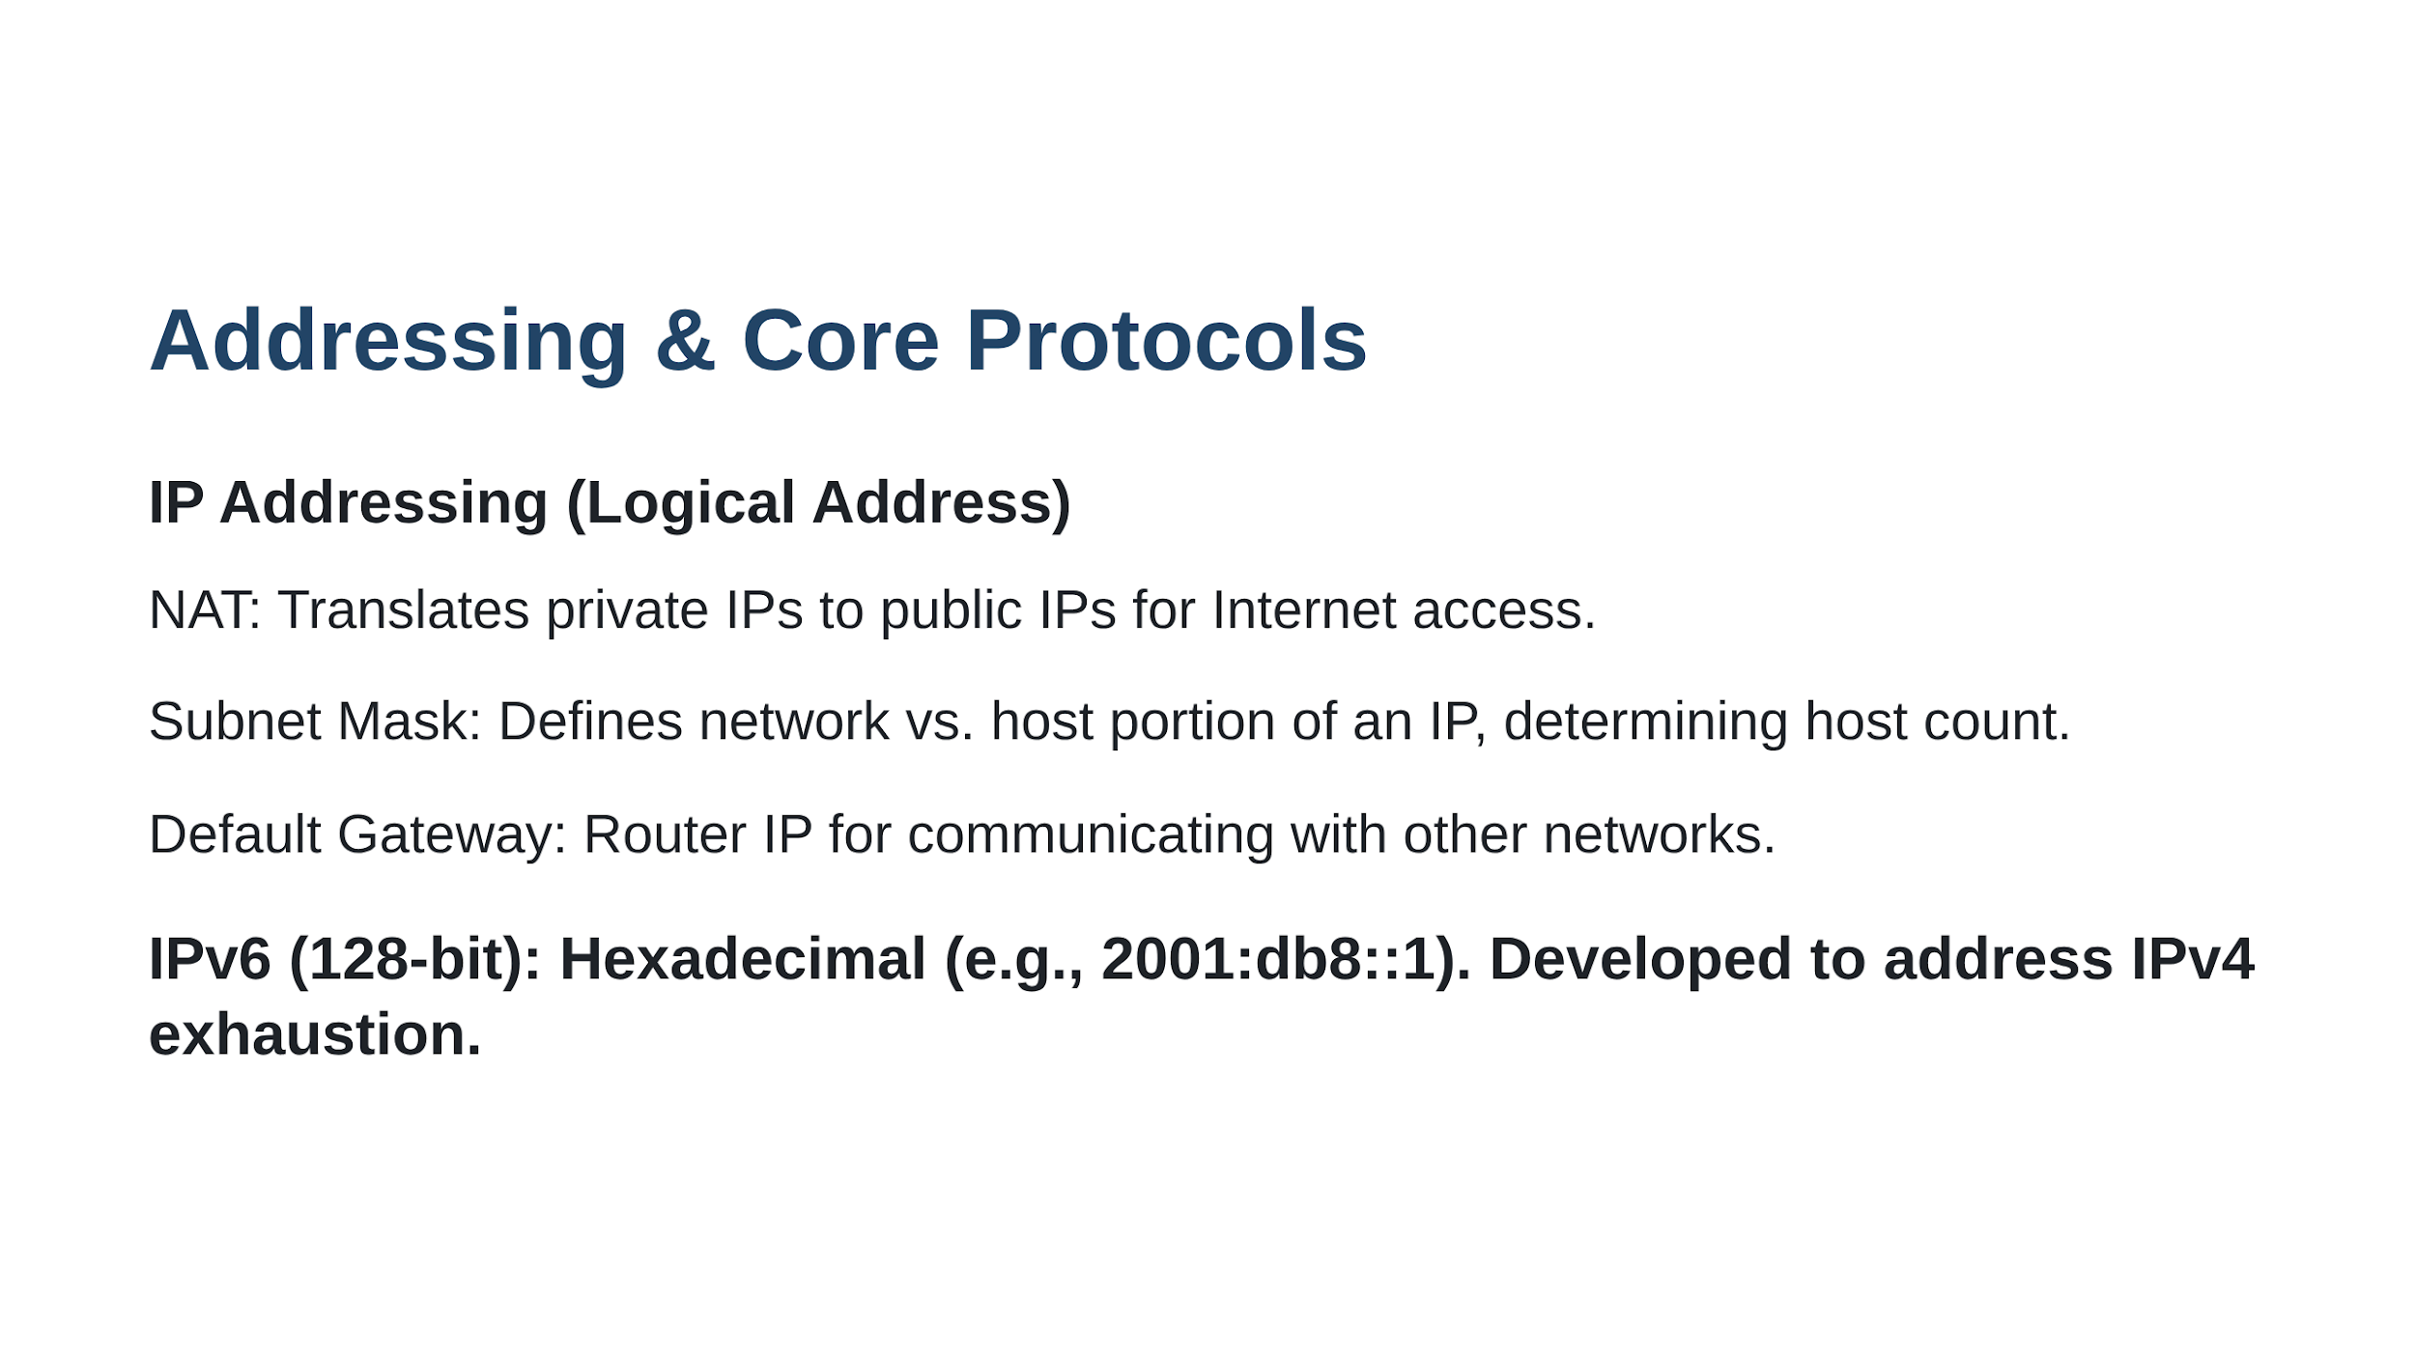

Slide 32
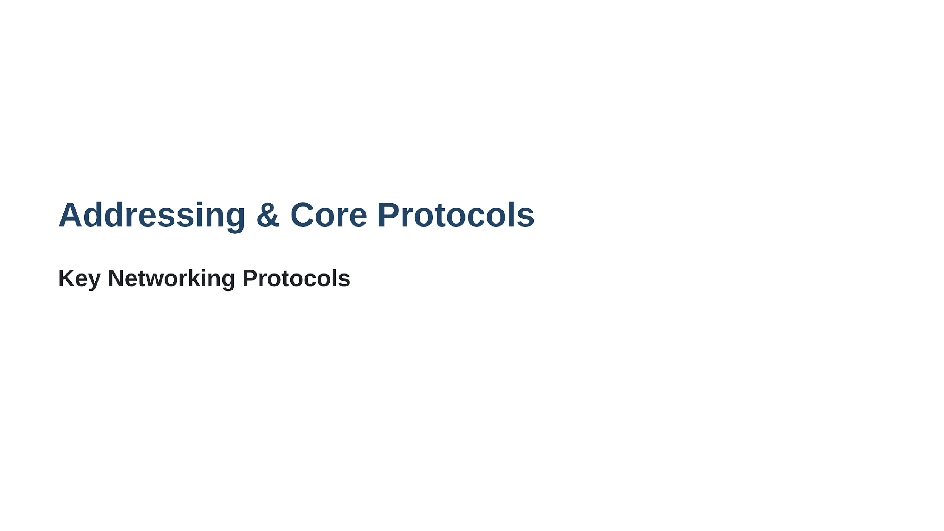

Slide 33
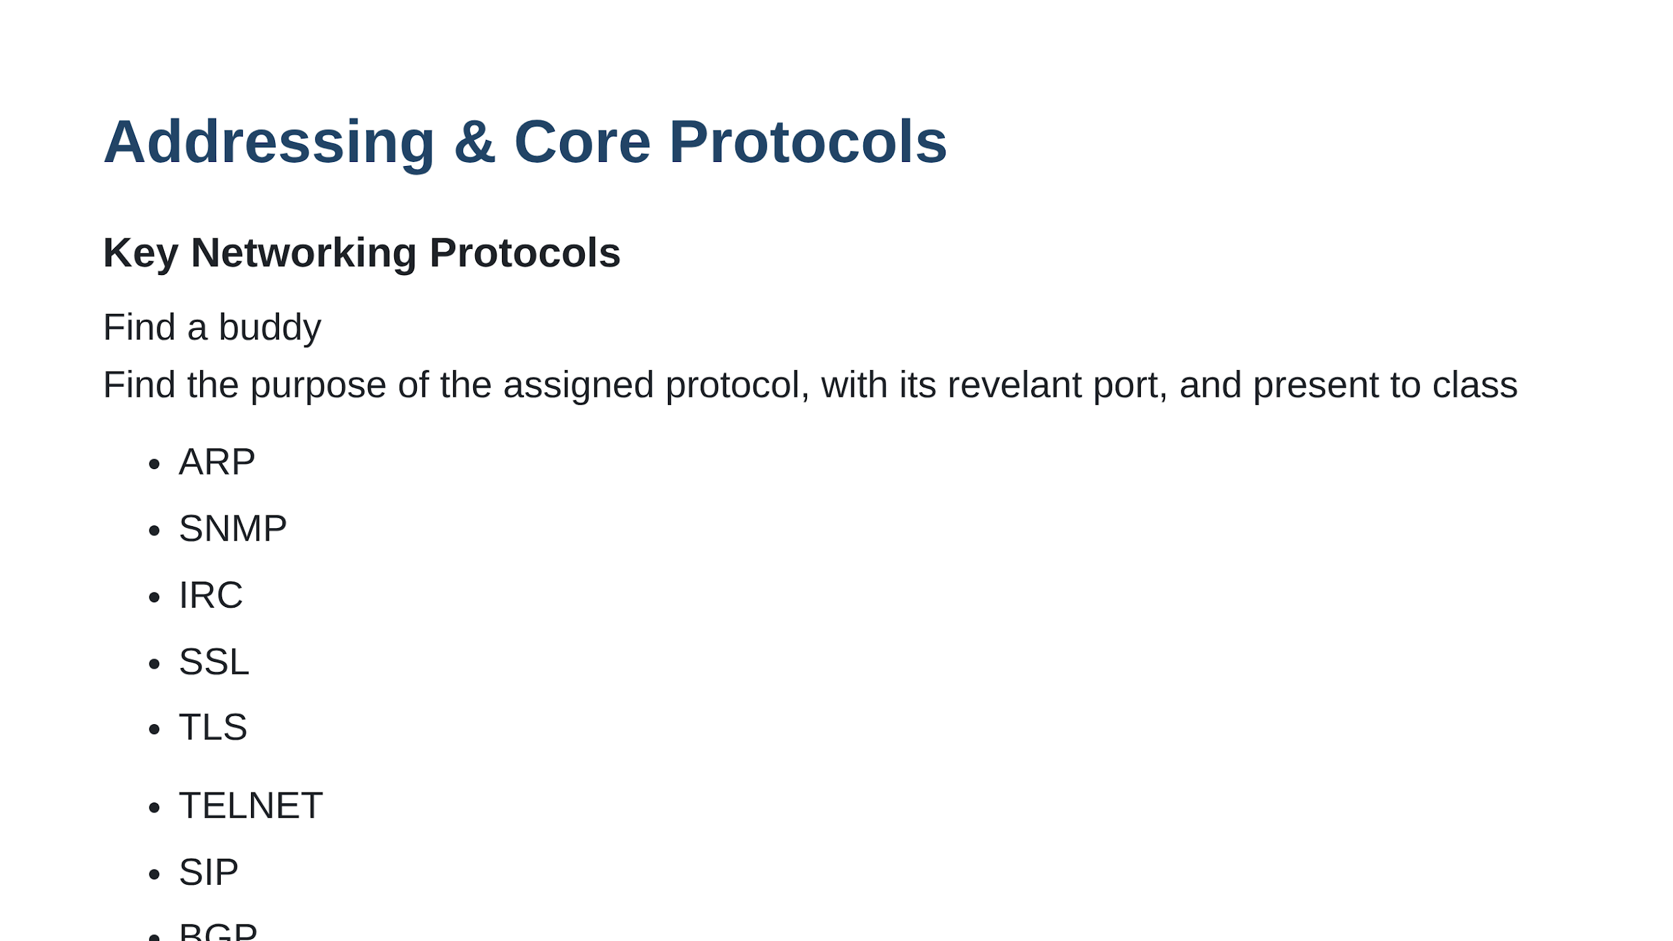

Slide 34
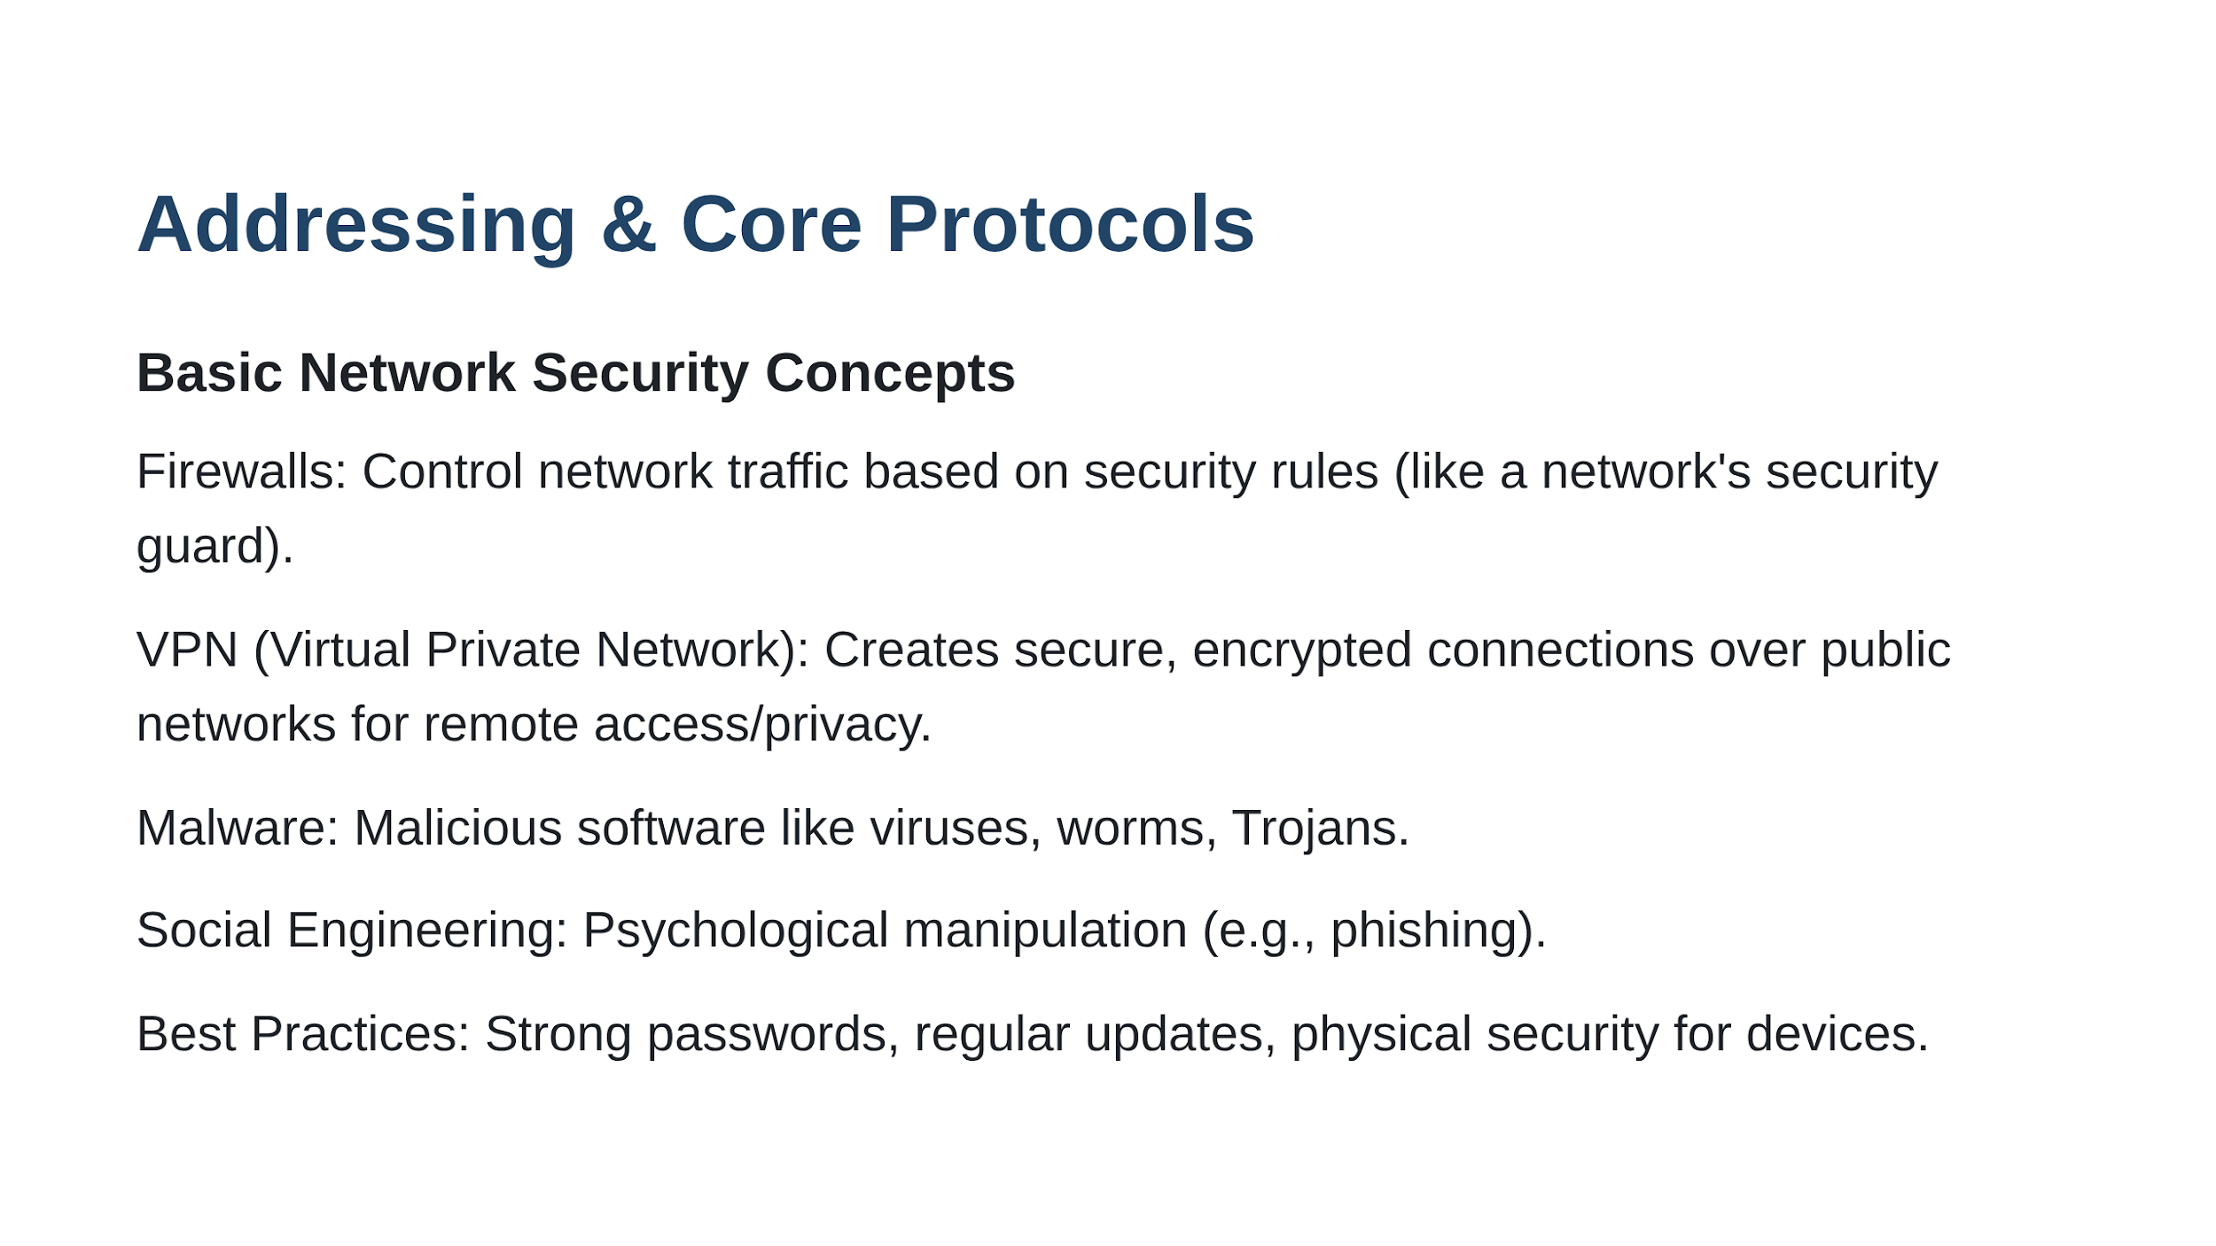

Slide 35
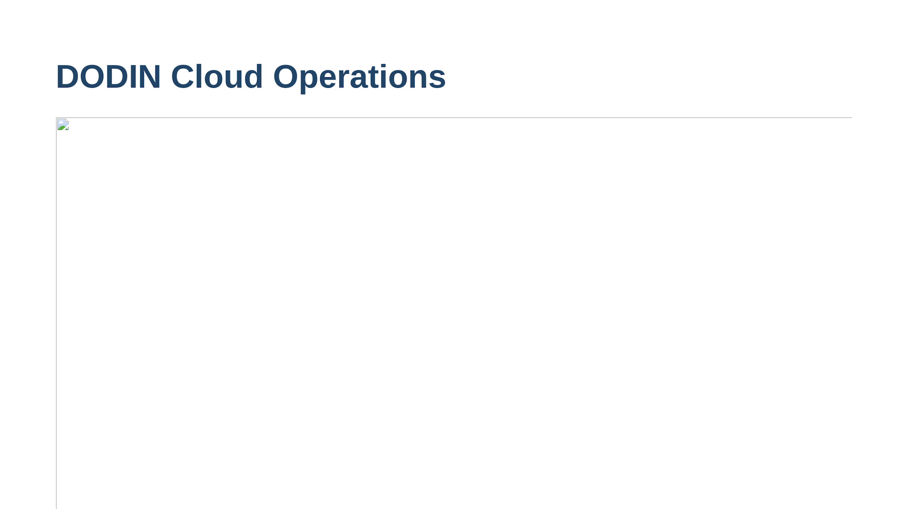

Slide 36
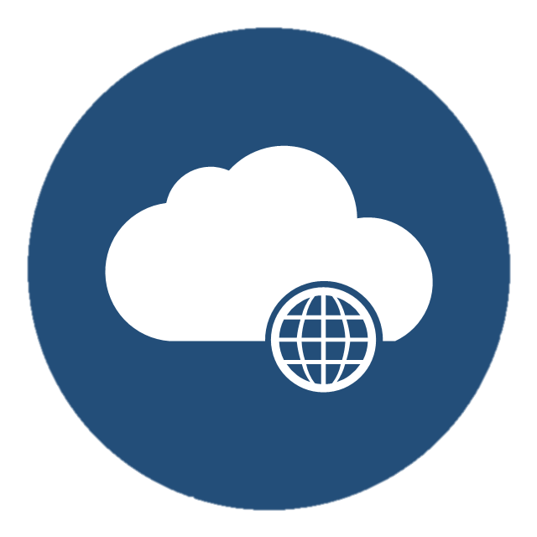

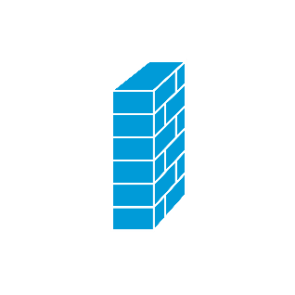

Networking (cont.)
Internet
COMMERCIAL(IL2) TRAFFIC INTO DODIN
IAP
Commercial CSP
DODIN
BCAP
GOVCLOUD CSP
Notes:
These slides will show in simple term how traffic flows from or to the DODIN via the internet, Commercial CSP, or GOVCLOUD.
Keep in mind every Agency (Army, Air Force, Navy, etc) have different security requirements and may have additional network protection and monitoring devices.
**
The first example is traffic from the DODIN to a Commercial CSP.
**
When a DODIN user types in a URL of a website, the DODIN internal Domain Name Server resolves that the website is hosted in a commercial Cloud Service Provider. It then routes the traffic out through the Internet Access Point or IAP. **
IAPs are the secure central connection point which is the barrier between the DoDIN and commercial Internet. The Defense Information Security Agency (DISA) inspects and manages all traffic inbound/outbound at the IAP, rules to ensure unsecure, unauthorized, or inappropriate internet connections are usually managed at the organizational level with web filtering and Firewall rules. DISA manages the final inbound/outbound traffic firewall rules at the IAP.
**
**
If allowed outbound through the IAP the traffic continues on via regular internet routing to its application/workload in the commercial CSP.
**
**
Inbound DoDIN traffic from non malicious users follows the same rules. It routes via commercial internet.
** **
It is inspected at the IAP and if deemed non-malicious allowed to access the DODIN resources.
This is how sites like organizations sharepoints are accessed from home computers.
** **
Malicious inbound traffic to the DODIN is inspected same as all other traffic at the IAP and will be stopped here when deemed unsafe or unauthorized.
DISA has internal SOP for dealing with this kind of traffic.
** ** **
However malicious traffic that tries to gain access to commercial workloads is completely left up to the Application security, that is not to say it is unsecure but DISA play no part in the security of this traffic.
ATO
ATC = ATO, SCCA, CSSP, IPs

Slide 37
Networking (cont.)
Internet
GOVCLOUD TRAFFIC INTO DODIN(BEFORE ATO)
IAP
Commercial CSP
DODIN
BCAP
GOVCLOUD CSP
Notes:
In this scenario we will take a quick look at traffic to GOVCLOUD. This example shows IL2 ATO’d traffic or IL4/5 traffic that has not yet been ATO’d and connected to the DODIN.
**
Much like traffic to commercial CSPs when a DODIN user tries to reach a GOVCLOUD application the traffic must go through the IAP and be inspected. **
Once through it travels through the commercial internet to reach GOVCLOUD CSPs.
While all GOVCLOUD CSPs have been FEDRAMPed approved as described before, the application is security is completely up to the Mission owner.
As part of the Cloud Shared Responsibility model, CSPs aren’t liable for network traffic allowed in by the Application/Workload owner.
And this reflects as well for valid and malicious user traffic coming from the internet as well.
All security is up to the application mission owner.

Slide 38
Networking (cont.)
Internet
GOVCLOUD TRAFFIC INTO DODIN(AFTER ATO)
IAP
Commercial CSP
DODIN
BCAP
*ATO SIGNED
*ATC APPROVED
*DISA IP’s
GOVCLOUD CSP
Connect to BCAP
Notes:
And our last example is how traffic that is IL4/5 ATO’d and has been connected to the DODIN.
**
Once all requirements of ATO have been signed as well as other DISA requirements, ** Cloud workload owners will connect to the Boundary Cloud Access Point or BCAP.
The purpose of the BCAP is to protect the DODIN by serving as a point defense to detect and prevent intrusion, unauthorized routes, known malicious code and malicious network activity.
A quick note, BCAPs are the currently the standard Cloud Access Point approved for Army use. Other Cloud Access Points do exist but they require a DoD CIO Exception to Policy.
Once connected to the BCAP the Commercial CSP workloads are given new IPS and become and extention of the DODIN.
This completely changes the routing of the cloud workloads, as this application or environment is no longer directly accessible from the general internet.
For internal DODIN traffic to GOVCLOUD Applications, users will not go out the IAP, they will instead go through the BCAP, be inspected and if authorized they will move on their application.
For external users to access these ATO’d environments they will now route via the internet to the IAP,
Thee IAP will block malicious and unauthorized users and authorized users and traffic will forwarded to the BCAP.
At the BCAP users will be inspected again and once through the users will have to go through the application security and identity to be authorized to access the data or service.
There are separate concepts such as Internal Cloud Access Points (ICAPs) which are required for on-prem cloud based solutions but are beyond the scope of this presentation.
This concludes the overview of the routing from DODIN to commercial or GOVCLOUD CSPs. Understanding these traffic flows can help ensure you are not breaking security authorizations by having higher impact levels of data on unauthorized networks.

